Slide 1
Session 1

Slide 2
Preparation slide – Hide this slide
Have the room set up in a large u-shape or large square
Mission/Vision and Values Poster on wall
Materials
Name Tent
Mission/Vision/Values
Markers
Flipchart
Colored stickers
Yes, No, Maybe cards – Optional
Notes:
Materials
Pens/pencil for each participant
Participant packet
Name tent
Organization M/V/V
Markers
Flipchart Paper
Yes/No/ Maybe cards
Pre scan
Flipchart with the topics that will be covered in class
2 different colored sticker for each person.

Slide 3
Presenter
Betsy Gadbois
Bgadbois@starsvcs.com
STAR Services
1295 Bandana Blvd. North Suite 135 St. Paul, MN 55108
651-644-3140 (phone) 651-641-0346 (fax)
www.starsvcs.com

Slide 4
Minnesota Diversified Industries
https://www.mdi.org/
Notes:
You are being offered this opportunity because of a grant to MDI.
MDI is a non-profit manufacturer of standard and custom corrugated plastic as well as a provider of assembly and environmental services. For over 50 years, MDI has provided meaningful employment in an inclusive environment with nearly half of its 400 employees being people with disabilities. It has four locations throughout Minnesota including Cohasset, Grand Rapids, Hibbing and Minneapolis. MDI also provides job placement assistance to help people with disabilities secure employment at area businesses that pay a competitive wage.
The work skills training program was originally launched in 2017, and 120 MDI employees and community members successfully completed it to date. Through a partnership with Advanced Minnesota, training is open to MDI employees, members of the public, and area high school students with disabilities who are approaching graduation and in need of assistance with transition to employment.

Slide 5
Over 120 participants
MDI employees and community members
Minneapolis
Hibbing
Cohasset
Grand Rapids
Notes:
Work Skills 101 (WS101) now called Career Skills curriculum was designed, developed, and piloted for Minnesota Diversified Industries (MDI) by Maven Perspectives LLC in 2017. It has been updated and modified as we learn more about what works best for participants.
It is an integrated, strengths based, soft skills development program. Fundamental to the program is that it was built to apply to all learners. It honors the strengths of individuals (where they are at) and grows their strengths and skills from each unique starting point.
The recommended cohort size is a maximum of 10 participants to ensure individual attention and to build a cohesive team. A support person may be necessary. It is 11 sessions and a Graduation Ceremony.
The recommended session sequence is provided here. Trainers are encouraged to be flexible with the sequence and to rearrange the session topics, as needed, to meet participants “where they are”.
It is recommended that trainers read the program curriculum in its entirety prior to the start of any cohort. Interjecting tidbits from both future and past topic areas into all sessions wherever possible, enables participants to hear the information multiple, repetitive times and will assist in their learning.
Every session should point to the mission/vision/values of the company. Major themes that should be woven throughout the program include: “We are all human.” “You are the CEO of your own life.” “Yet! You haven’t done/learned/experienced it yet.” Every session should give participants the opportunity to stand and speak in front of the group.
Over 120 participants to date in 101 and many more in 201

Slide 6
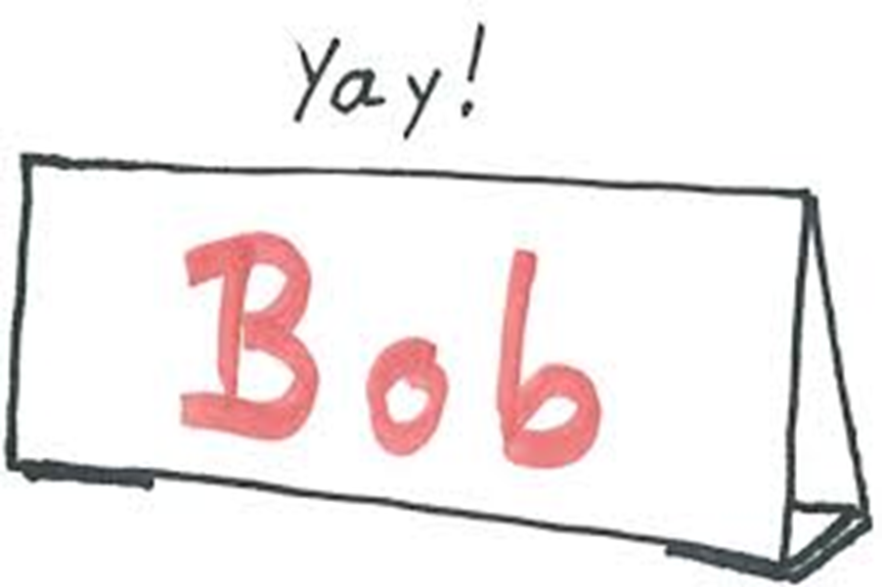
Please make a name tent

Slide 7
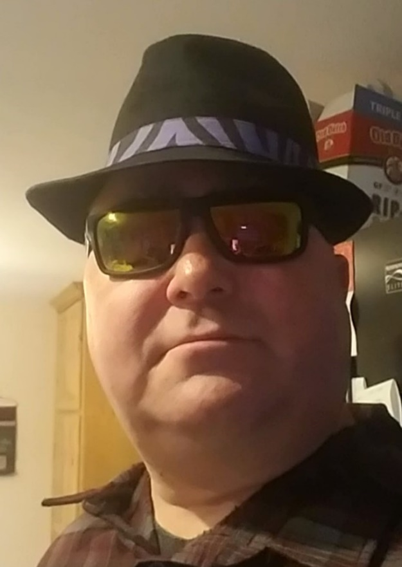
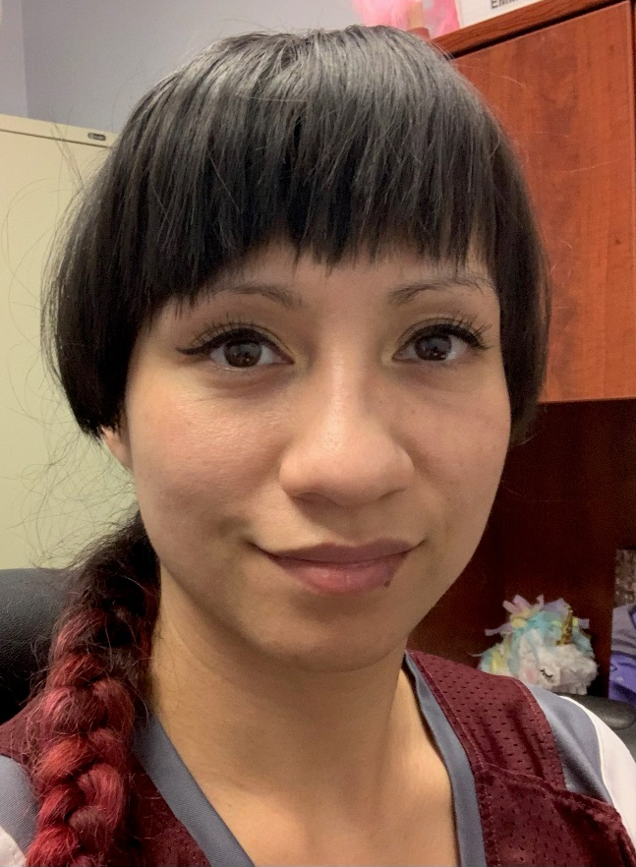
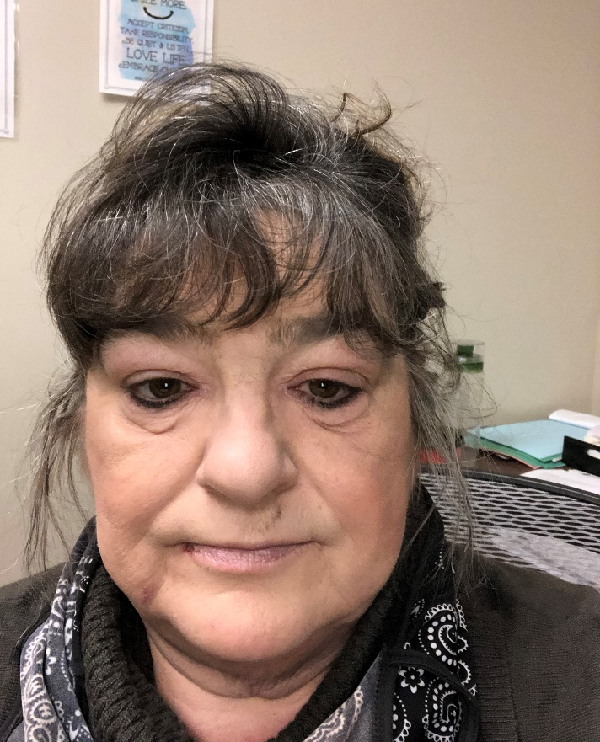
Co-Trainers
Dan
Rhea
Alice

Slide 8
Ice Breaker
Notes:
What is an icebreaker?
An icebreaker is an activity, game, or event that is used to welcome people and warm up the conversation among participants in a meeting, training class, team building session, or another event. Any event that requires people to comfortably interact with each other is an opportunity to use an icebreaker
We will have an icebreaker at the beginning of each class, to help you get comfortable talking in front of a group.
Ask each person to stand up and share their name, a job they would love to have and why.
Ask the group “ why is it important to get comfortable talking in front of a group? How will that help us in our jobs?

Slide 9
Roles and Responsibilities
Your Role
To participate and learn
To show-up (on time)
To have FUN
To discover your strengths
To find SUCCESS for
You
Your organization
Community
My Role
To be prepared
To present new ideas
To create an environment where you want to learn.
To help you see your potential
To prepare you to have your BEST work life
Notes:
Read out loud the roles and responsibilities of the participant and the instructor's
Participants Role:
To learn, participate and make changes that will help you in your job
Show up
Have fun
Discover your strengths and how they contribute to your success, MDI’s success and to community success
My Role as a trainer:
Present new idea
Create a learning atmosphere
Help you see your potential
Prepare you with information to live your best work life

Slide 10
Program Theme
We are each the CEO of our own lives.
Notes:
Ask what is CEO
CEO is being the boss. We are the CEO/Boss of our own lives.
Discuss that we are responsible for the things that happen in our lives. We are in charge.
Ask questions and ask the group who is responsible.
What if we are late for work – who is responsible
If we come to work without our lunch
We are late coming back from break
We get the job we were hoping for
We get a raise
We forget to do our laundry
We want to take responsibility for ourselves in every situation. Move away from blaming others or waiting for other to make things better for us.
Use this theme often during the training

Slide 11
What we will learn
Mission, Vision and Values
Proper greetings
Goal Setting
Attitude and Grit
Time Management and Punctuality
Initiative and Leadership
Understanding Personality Type
Communication Skills – Feedback and Criticism
Notes:
Review the next 2 slides. Describe the topics and have them on a flipchart.
Ask each participant to put one color sticker on the topic they think they know the most about or are really good at, ask them to put a sticker on the one thing they would like to learn about.
We are also working on helping people to be comfortable speaking in front of a group.

Slide 12
What we will learn
The Importance of Reputation
Work Efficiency
Teamwork
Problem Solving and Critical Thinking
Workplace Culture
Community Connection and Social Capital
Preparing for Interviews

Slide 13
Thought for the Day
The only person you are destined to become is the one you decide to be
Ralph W. Emerson
Notes:
Each class will have a thought for the day. Share the thought for the day and ask the group what it means to them. Share what it means to you.
You can change the thought for the day if you have one that fits better for you.

Slide 14
Mission, Vision, Values of MDI
Mission – Serving people with disabilities by offering inclusive employment opportunities and production services.
Vision – Meaningful employment opportunities for all people.
Values – Employee and Customer First, Positive Attitude, Respectful, Do the Right Thing, Empower individual Ability
Notes:
Instructors add your organizational mission, vision and values here.
Review with the group. Ask them what it means.
Ask them what that looks like what things do people see in the organization that tell the organization has this mission, vision and values.
Each class will begin with a review of the M/V/V statement of the organization

Slide 15
Mission Moments
Notes:
Mission Moments are everyday stories of great things happening in your organization that match your mission.
I define a “mission moment” as a tiny, powerful example of how your organization is making an impact. The key is: it MUST be an example about a real person. Even if you do advocacy work or are an environmental charity, it has to be a people story. Mission moments put a face on what you do. They are stories and examples that can be repeated by others because they are short and inspiring.
They allow you to brag about your work through someone else’s eyes
Each class will start with a Mission moment.
Instructor share a mission moment about the great things your organization is doing. Ask for other stories and ask participants to be thinking about a mission moment for out next class.
When you are looking for a job you want to be sure that the mission of the organization matches your personal values. Personal values are what is important to you at work. What if it doesn’t?

Slide 16
Professional Greeting
Notes:
The first thing to learn in Career Skills is how to greet people. This is the first step in professionalism.
Every greeting and introduction is an opportunity to demonstrate respect for others and to create a favorable impression of yourself to others. When you greet someone, you acknowledge their presence.
Ask the questions is this a professional greeting?
Ask what a professional greeting is?

Slide 17
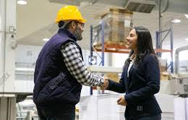
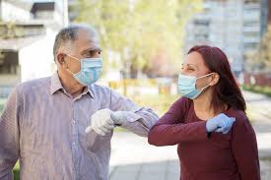
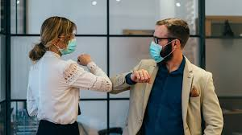
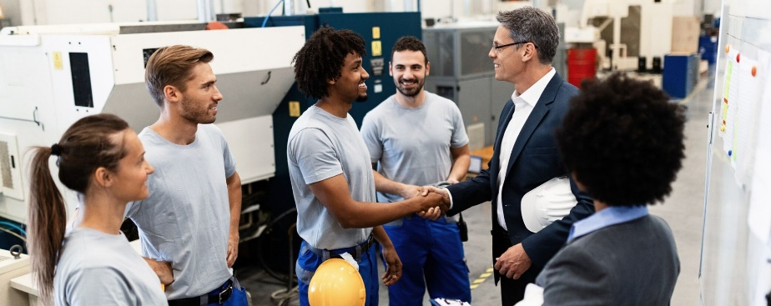
Professional Greeting
Notes:
Review a proper greeting and professional handshake with the group.
Demonstrate by shaking hands with each person around the table.
Proper Greetings:
Being professional
honor the other person with a proper handshake
eye contact
smile
repeating the person’s name
raising eyebrows
leaning in a bit
firm hand
What if you have been ill?
What about if you are ill? Tell person you are “ill” hands together/elbows “It is a pleasure to meet you, my name is ______”
If you are sitting, stand if someone approaches you

Slide 18
Getting to know each other
Notes:
Pair people up. Have them greet each other.
Have the teams sit down and have a conversation.
The goal is to learn 3 cool/interesting things about your partner.
After they have talked to each other have them introduce their partner to the group.

Slide 19
10 Minute Break

Slide 20
Setting Goals
Notes:
Today we are going to talk about setting goals
Ask the group – What is a goal
A goal is an idea of the future or desired result that a person or a group of people envision, plan and commit to achieve.
They help us grow as a person and as an employee
Why have goals?
Planning using goals is important to moving our life forward
Goals give us something to work towards; to strive for
People that have goals tend to be happier people and more productive.
Goals hold us accountable.
Goals also change over time.

Slide 21
SMART Goals
S – specific
M – measurable
A – attainable
R – realistic
T – time sensitive
Notes:
SMART GOAL (place on flip chart and discuss each; find own words for each
Specific – not too general, know it when you see it
Measurable – when can put numbers too it, save XX$ for vacation, complete this 6 times to learn it well , add 1 more day to my schedule per week. You will know when you have accomplished it.
Attainable – do you have the “will” to accomplish it, can you see the path to get there
Realistic – fits me and my life,
Time Sensitive – determine a time frame; in 3 months, next year, etc drive the forklift in 90 days
It is not 80% of the time for 3 consecutive months.

Slide 22
Dare to Dream
Notes:
In your small group - discuss where do you see yourself in 5 years – Trainer should be prepared to do this too.
Working at a job I love
In my own apartment
Getting married
Write your goal down.
Ask the questions:
Is this hard to do?
Had you thought much about this before?
What will it take to get there?

Slide 23
Dare to Dream
5 year:
Retired and working doing consulting. Living in Talmoon
1 year:
Training a new class called People Planning Together
Notes:
Trainers add your examples to the slide
Work with each participant to set a one-year work goal.
Give examples relevant to the person and the organization.
Learn to drive a forklift
Enter my time using the computer
Get a job at Bath and Body Works
Complete my culinary class at the tech college
To sell 10 of my photographs
To work enough hours to earn vacation
Get more hours at work
Does the goal fit a smart goal?
Share the goals with the group and put it on the flipchart to leave on the wall for review
Next focus on Action steps.
Identify one next step. Steps you need to reach goals are called ACTIONS – help each other brainstorm actions to reach goals
Focus on work – we will use these in our celebration presentations.
We will share with our supervisors
Goals should be like your own. We do not need 80% of the time for 6 consecutive weeks.

Slide 24
Successful people that set goals
They work hard to achieve them
Notes:
Show the next 3 slides and read the stories that go with them.
Talk about what they all have in common
They never gave up
Belief in themselves
Ask the group if they know of people that have set goals. In our class, Kristie wanted to be the front desk receptionist. She set a plan and talked to the right people and is very successful in her new role.

Slide 25
J.K. Rowling
Notes:
J.K. Rowling
Had just gotten a divorce, was on government aid, and could barely afford to feed her baby in 1994, just three years before the first Harry Potter book, Harry Potter and The Philosopher’s Stone, was published. When she was shopping it out, she was so poor she couldn’t afford a computer or even the cost of photocopying the 90,000-word novel, so she manually typed out each version to send to publishers. It was rejected dozens of times until finally Bloomsbury, a small London publisher, gave it a second chance after the CEO’s eight-year-old daughter fell in love with it.

Slide 26
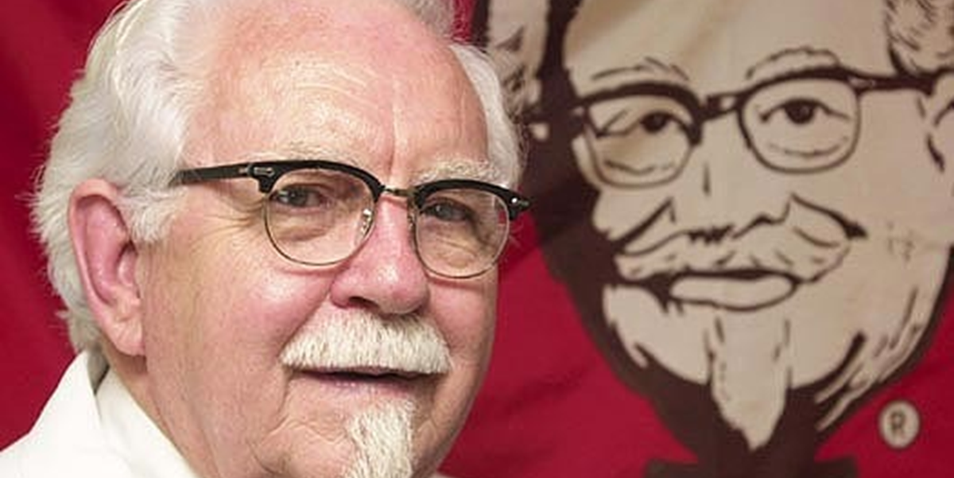
Colonal Sanders
Notes:
Colonel Harland Sanders
Was fired from a variety of jobs throughout his career before he first started cooking chicken in his roadside Shell Service Station in 1930, when he was 40 years old. His gas station didn’t actually have a restaurant, so he served diners in his attached personal living quarters. Over the next 10 years, he perfected his “Secret Recipe” for his famous fried chicken and moved onto bigger locations. People loved his chicken. However, as the interstate came through the Kentucky town where the Colonel’s restaurant was located in the 1950s, it took away important road traffic, and the Colonel was forced to close his business and retire, essentially broke. He set out to find restaurants who would franchise his secret recipe—he wanted a nickel for each piece of chicken sold. He drove around, sleeping in his car, and was rejected more than 1,000 times before finally finding his first partner.

Slide 27
Oprah Winfrey
Notes:
Oprah Winfrey
She dealt with a lot throughout her public life—criticism about her weight, racism, intrusive questions—but she never let it get in the way of her ambition and drive. When you look at her childhood, her personal triumphs are cast in an even more remarkable light. Growing up, Oprah was reportedly harmed by family members. But Oprah persevered, going on to finish high school as an honors student, earning a full scholarship to college, and working her way up through the ranks of television, from a local network anchor in Nashville to an international superstar and creator of her OWN network.
Aske the group – Who else can they think of?

Slide 28
Homework
Find the mission of an organization you like or would like to work for
Practice proper introductions
Share your goals with another person
Tell one person about your class and what you are learning

Slide 29
Thoughts or Questions?

