Slide 1
Session 2

Slide 2
Ice Breaker
Notes:
Instructor asks each participant to share one “brag” about themselves. This could be something they are great at or something they are proud of. Point out the positives!!!

Slide 3
Homework
Find the mission of an organization you like or would like to work for
Practice proper introductions
Share your goals with another person
Tell one person about your class and what you are learning

Slide 4
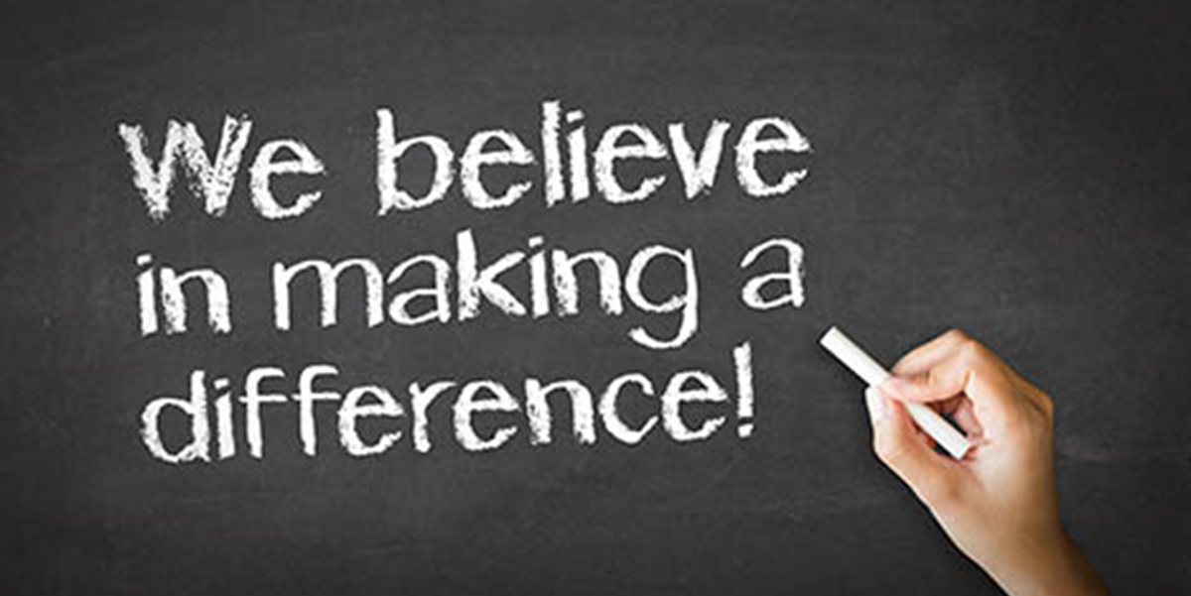
Mission Moments
Notes:
Mission Moments are everyday stories of great things happening in your organization that match your mission.
I define a “mission moment” as a tiny, powerful example of how your organization is making an impact. The key is: it MUST be an example about a real person. Even if you do advocacy work or are an environmental charity, it has to be a people story. Mission moments put a face on what you do. They are stories and examples that can be repeated by others because they are short and inspiring.
They allow you to brag about your work through someone else’s eyes
Each class will start with a Mission moment.
Instructor share a mission moment about the great things your organization is doing. Ask for other stories and ask participants to be thinking about a mission moment for out next class.
When you are looking for a job you want to be sure that the mission of the organization matches your personal values. Personal values are what is important to you at work. What if it doesn’t?

Slide 5
Grit
Notes:
Ask the group what is GRIT.
Describe
GRIT= Resiliency + Determination + Perseverance + Optimism.
GRIT requires focus.
Trainer describe each of the qualities and ask for an example from the group for each
The ability to bounce back from adversity is called resilience.
The ability to do whatever you set your mind to is called determination.
The ability to walk through issues (with the help others and connections with resources) is called perseverance.
To come out on the other side happy is called optimism. Optimism and a positive attitude affect grit.
Share a story or ask for a story from the group when someone showed GRIT.
Relate grit to working on our goals even when things are tough.

Slide 6
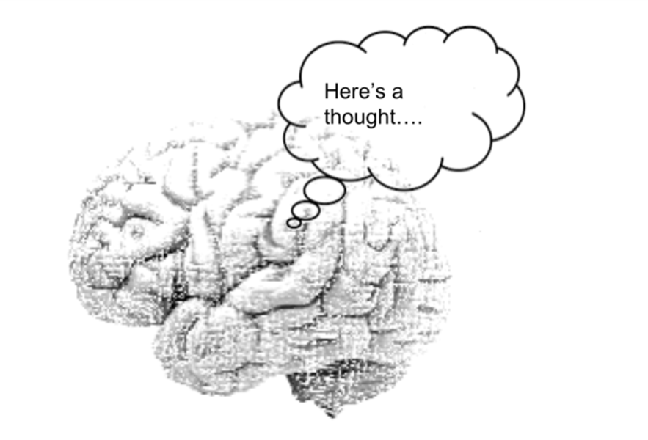
Thought for the Day
Gritty people have a mindset, when bad things happen, they don’t give up.
Angela Duckworth
Notes:
Review a proper greeting and professional handshake with the group.
Demonstrate by shaking hands with each person around the table.
Proper Greetings:
Being professional
honor the other person with a proper handshake
eye contact
smile
repeating the person’s name
raising eyebrows
leaning in a bit
firm hand
What if you have been ill?
What about if you are ill? Tell person you are “ill” hands together/elbows “It is a pleasure to meet you, my name is ______”
If you are sitting, stand if someone approaches you

Slide 7
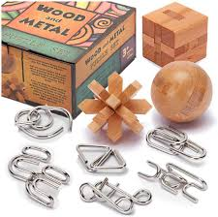
Practice
Notes:
Using small handheld games or brain teasers set up grit stations. Give people a chance to move through.
Ask – what was that experience like, could you do it? Did you want to give up? What would it take to be successful?
What was your favorite?

Slide 8
Importance of a positive attitude
Notes:
Optimism and positive attitude are key to success.
We cannot control everything that happens in life, but we can control our attitude.
Remember we are the CEO/Boss of our own life.
Ask the group to draw a picture of a good attitude and a bad attitude.
On a flipchart put the heading attitude
One column with good and one column with bad
Ask participants to show their pictures and ask how it makes them feel. Put the words on the flipchart.
Agree that positive attitudes bring joy.
What attitude do we want in our Career Skills class? AS the CEO of your life what attitude do you usually have.
What can this group do to share a positive attitude? Can the poster be put in the lunchroom or hallway to share with others?

Slide 9
Be Positive
Take your marker home.
Put a + or a smile face or a post-it note on your mirror to remind you to start each day with a positive attitude.
Report back at the next class.
Notes:
Give each participant a dry erase marker to take home to do the activity.

Slide 10
Break Time

Slide 11
Punctuality and Attendance
Notes:
Ask: How long does it take to make a habit?
Ask: What does it mean to be punctual?
Ask: What happens when you are late?
When you are late you, you are saying your time is more important than mine
Ask: Whose fault is it when you are late

Slide 12
Skit
3 volunteers
Ted
Jerry
Don
Notes:
Supervisor: There is a tremendous amount of work that has to be done today. Everyone will need to be in position and on their toes.
Narrator: Everyone is busy working, getting the line set up and the plastic in place.
Copy the script. Get 3 volunteers the trainer is the narrator.
Ted (employee 1): Hey, where is Don?
Jerry (employee 2): Man, I don’t know. I didn’t see him on the bus this morning. That guy is always late for work.
Ted (employee 1): I don’t know how we are going to get this order filled with one less person here today.
Narrator: Don comes strolling into the plant looking like he just fell out of bed. His hair is not combed, his clothes are a mess and he didn’t put on his safety equipment.
Ted (employee 1): Hey Don. You’re late.
Don (employee 3): Yeah I know
Discuss with the group
How does this effect other people?
How does this affect your employer?
Being on time mean BEFORE TIME 5-10 minutes How do we plan ahead in our personal life to be on time?

Slide 13
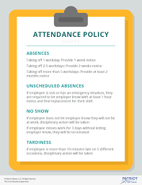
Attendance Policy
Notes:
Pass out copies of the organizations attendance policy. If people are not currently working use the staff attendance policy or one from another organization.
Discuss with the group and talk about why attendance is important.
Talk about common reasons people are late for work

Slide 14
Page Title
Separate into 2 groups
Create a list/poster of things you can do to be sure you are on time for work
Notes:
Have each group create a list of things they can do to be sure that they are on time for work
Ideas include
Get to sleep early
Make lunch the night before
Set your clothes out
Fill the car up with gas the day before
Stay away from sugar, caffeine, alcohol at night
Turn off your cell phone, computer or TV at a specific time
Get exercise
Shower at night

Slide 15
Homework
Demonstrate a positive attitude and be prepared to share with the class
Be punctual to all work, classes and personal engagements
Tell one person about your class and what you are learning

