Slide 1
Session 3

Slide 2
Ice Breaker
Notes:
Pair up with someone you don’t know well and ask them three questions.
What do you like to do in your free time?
Tell me about your favorite memory?
If you could go anywhere, where would you go?
Then introduce your partner to the group.

Slide 3
Homework
Demonstrate a positive attitude and be prepared to share with the class
Be punctual to all work, classes and personal engagements
Tell one person about your class and what you are learning

Slide 4
Mission Moments
Notes:
Mission Moments are everyday stories of great things happening in your organization that match your mission.
I define a “mission moment” as a tiny, powerful example of how your organization is making an impact. The key is: it MUST be an example about a real person. Even if you do advocacy work or are an environmental charity, it has to be a people story. Mission moments put a face on what you do. They are stories and examples that can be repeated by others because they are short and inspiring.
They allow you to brag about your work through someone else’s eyes
Each class will start with a Mission moment.
Instructor share a mission moment about the great things your organization is doing. Ask for other stories and ask participants to be thinking about a mission moment for out next class.
When you are looking for a job you want to be sure that the mission of the organization matches your personal values. Personal values are what is important to you at work. What if it doesn’t?

Slide 5
What does a great worker look like
Notes:
What does an employer look for in a great worker?
On a flipchart draw a picture of a person – ask participants to write words or draw pictures of what employer would look for in a great worker.
What if they were the CEO of the organization – What would they look for in a great worker
When the poster is done – review the list. Ask people to raise their hand if they are good at each item.
Discuss ways we can improve?
You are the CEO/Boss of your own life. The work must be done by you.

Slide 6
Leaders
Notes:
Ask what is a leader or what is leadership?
Leadership is action. It is not a position. We can all be leaders.
Activity: Shape Shifting with Leadership
Equipment: rope tied into a loop It should be large enough for everyone to hold with both hands while they stand together in a circle. Tell group to make a shape, such as a circle, square, triangle, etc. The group then tries to put the rope on the floor in that shape.
At the end of the activity talk about what the group saw. What worked and what did not. How did people work together? Did leaders emerge?
Who took initiative? Who followed along?
Look for leaders
Or African safari – see the next slide

Slide 7
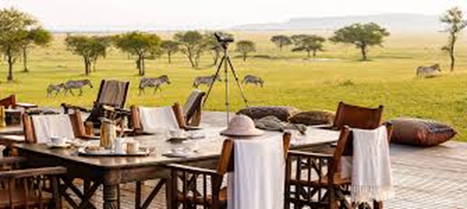
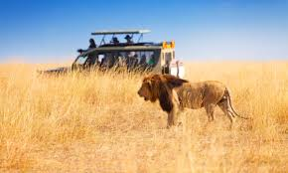
African Safari
Make a poster
Determine what you will need – skills and equipment
Where will you stay, how long will you be gone
Everyone must have a task before and during the trip
Who will do what
Notes:
Ask what is a leader or what is leadership?
Leadership is action. It is not a position. We can all be leaders.
At the end of the activity talk about what the group saw. What worked and what did not. How did people work together? Did leaders emerge?
Who took initiative? Who followed along?
Look for leaders

Slide 8
Following a leader
https://www.youtube.com/watch?v=fW8amMCVAJQ
Notes:
Show the video – First Follower, Leadership Lessons from a Dancing Guy.
Talk about the video – what did people think?
It took courage to be the first follower, what happened? How was a movement created?
Key points
Easy to Follow
Leader embraces
Find a follower
Simple
Takes Guts
Ask the group – who is a leader they would like to follow? Someone you respect? Someone that does great work.
Initiative definition - the power or opportunity to act or take charge before others do.
Leadership take initiative.
How do we take initiative to make things happen?
Review the next slides have people work in pairs and identify the problem. Ask the group how they could take initiative.

Slide 9
Break Time

Slide 10
How could you show initiative?
Notes:
Picture 1 – lots of work to do but nobody is doing it

Slide 11
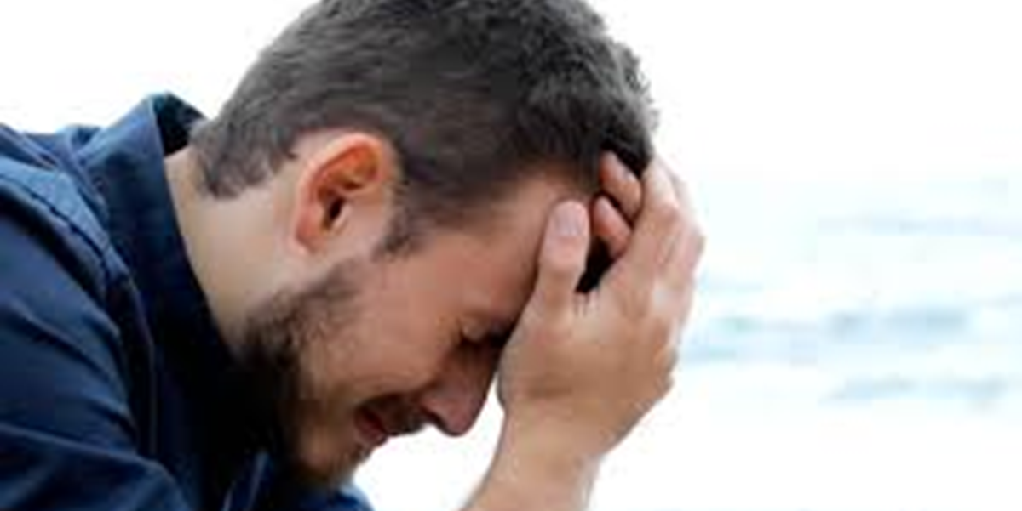
How could you show initiative?
Notes:
Picture 2 – someone very worried or sad

Slide 12
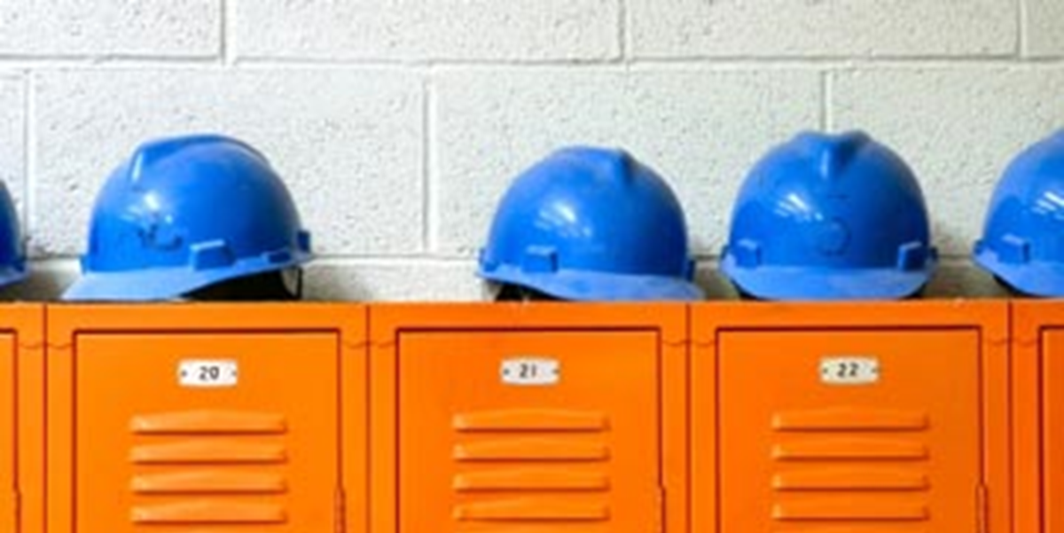
How could you show initiative?
Notes:
Picture 3 – safety equipment not being worn

Slide 13
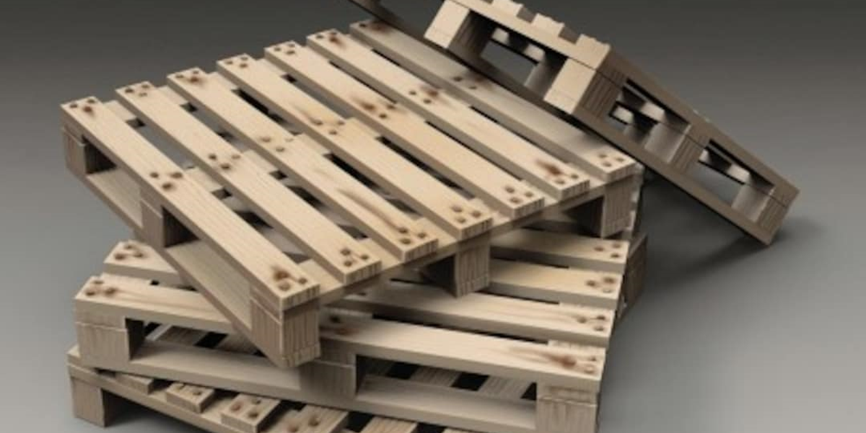
How could you show initiative?
Notes:
Picture 4 – pallets not stacked correctly

Slide 14
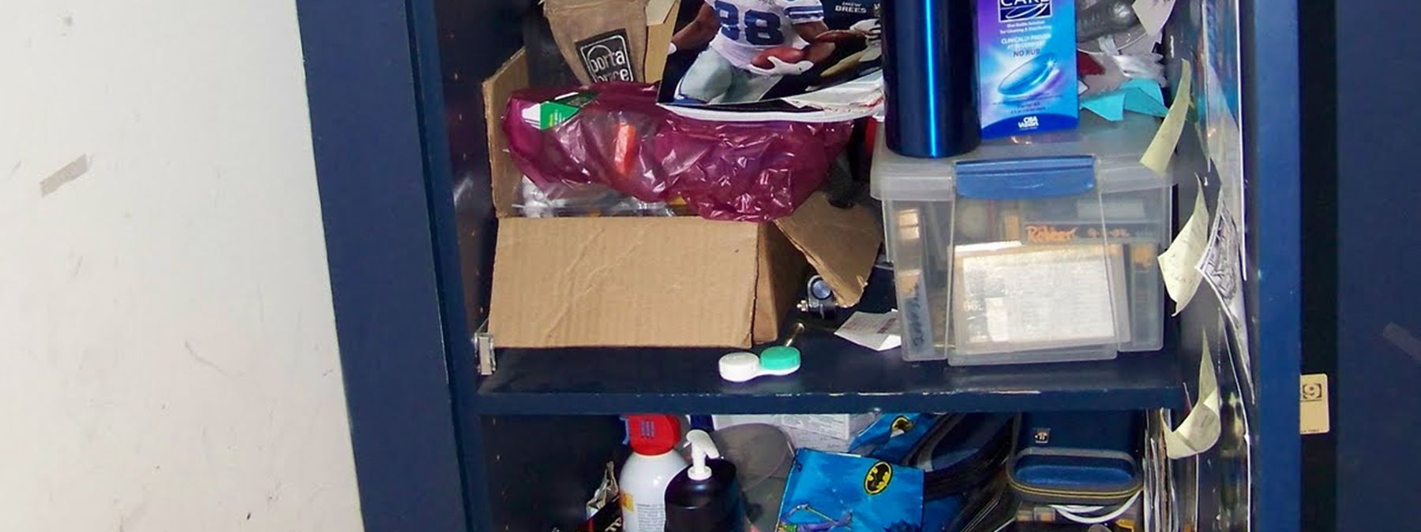
How could you show initiative?
Notes:
Picture 5 – very messy work locker

Slide 15
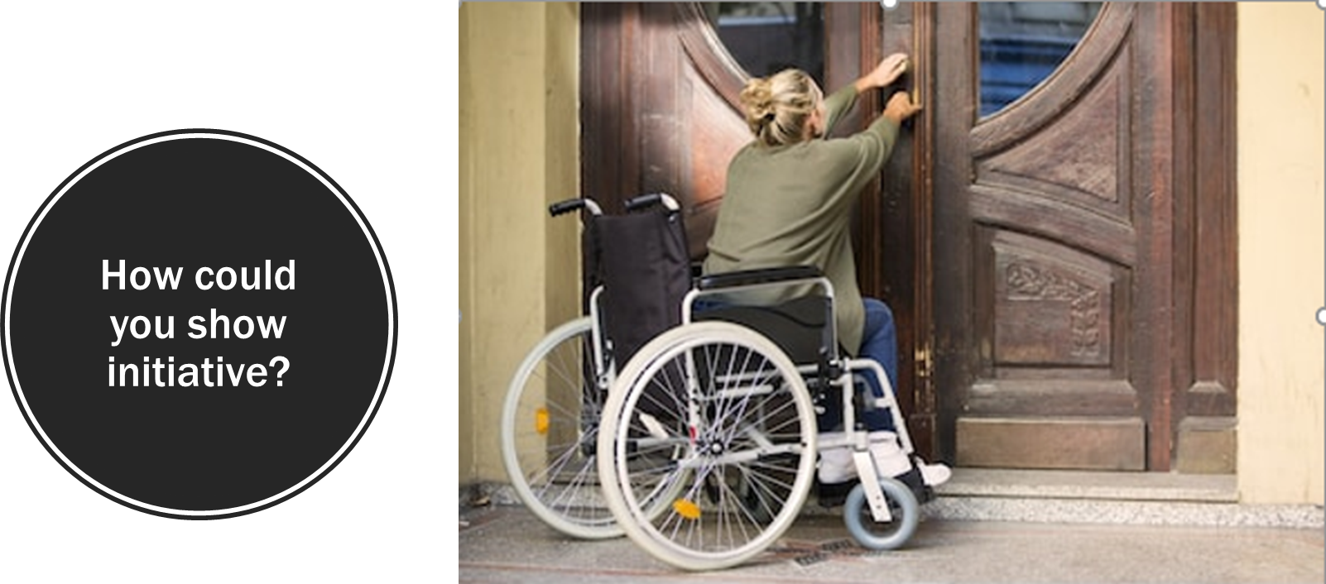
Notes:
Picture 6 – person in w/c can’t get in the door

Slide 16
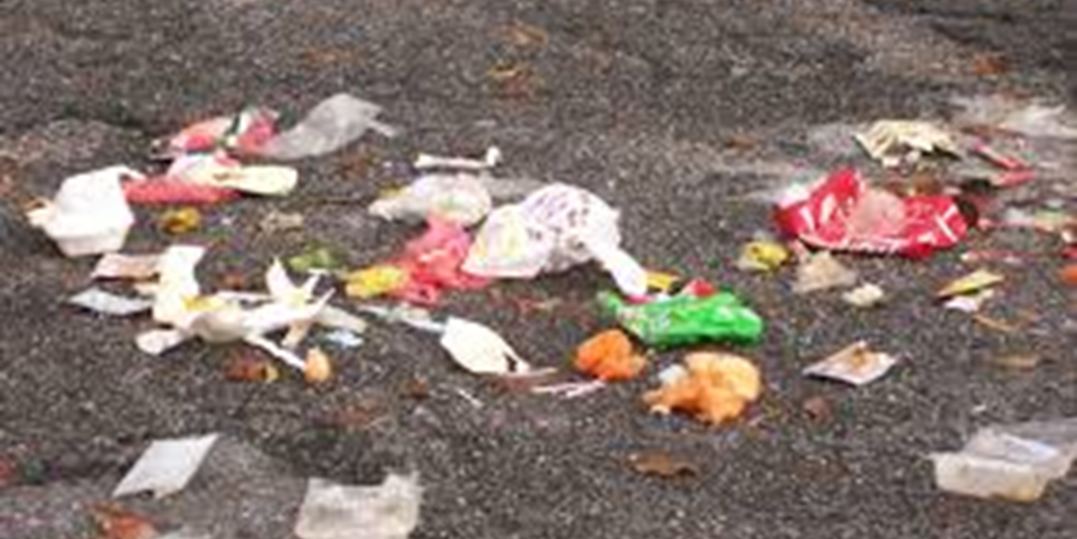
How could you show initiative?
Notes:
Picture 7 - Garbage all over the parking lot

Slide 17
Words to lead by
https://www.youtube.com/watch?v=tdmyoMe4iHM&feature=youtu.be
Notes:
Miracle on Ice Video
Talk about what they saw.

Slide 18
Mission MOMENT Thought for the Day

Slide 19
Homework
Demonstrate leadership and be prepared to talk about it.
Take initiative.
Tell one person about your class and what you are learning.

