Slide 1
Session 4

Slide 2
Ice Breaker
Notes:
Tell the group about a leader you really respect and why?

Slide 3
Homework
Demonstrate leadership and be prepared to talk about it.
Take initiative.
Tell one person about your class and what you are learning.

Slide 4
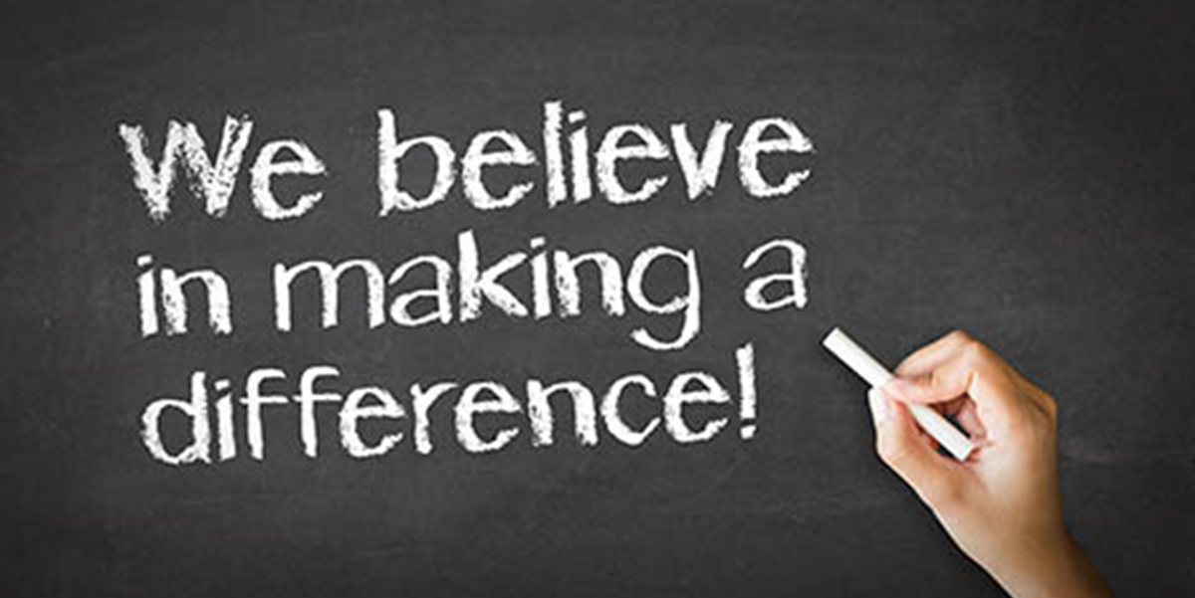
Mission Moments
Notes:
Mission Moments are everyday stories of great things happening in your organization that match your mission.
I define a “mission moment” as a tiny, powerful example of how your organization is making an impact. The key is: it MUST be an example about a real person. Even if you do advocacy work or are an environmental charity, it has to be a people story. Mission moments put a face on what you do. They are stories and examples that can be repeated by others because they are short and inspiring.
They allow you to brag about your work through someone else’s eyes
Each class will start with a Mission moment.
Instructor share a mission moment about the great things your organization is doing. Ask for other stories and ask participants to be thinking about a mission moment for out next class.
When you are looking for a job you want to be sure that the mission of the organization matches your personal values. Personal values are what is important to you at work. What if it doesn’t?

Slide 5
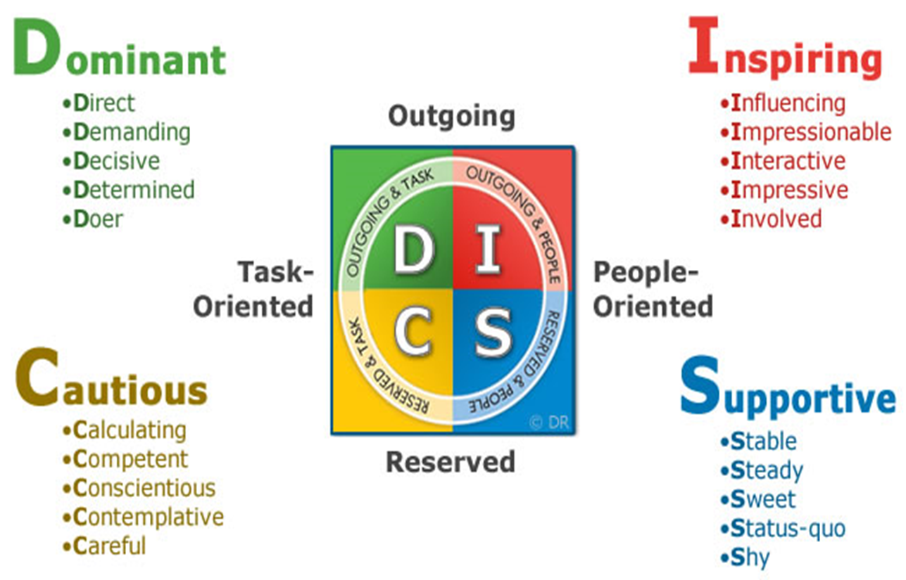
Notes:
Trainers should take the free DISC Profile prior to the class to get familiar and comfortable with the material.
https:/discpersonalitytesting.com/free-disc-test/ this will help you share the information with your class.
Activity: Using all 4 walls of room, label each with D – I – S – C starting at the front of room. Use colors
Determines your natural tendencies
Everyone has some components of each personality tendency. We all come by these naturally. No right or wrong answer. Personality factors that motivate our behavior
Ask: are you more outgoing or more reserved?
D/I Outgoing = face pace, high energy, move quickly, outgoing
C/S Reserved = even paced, methodical, need think time, reserved & slow paced
Trainer stand in middle of room. Move to which you are.
D/C Ask: Are you more task oriented? Focus on what I can get done, results oriented, focus on the purpose or outcome, details
I/S Ask: Are you more people oriented? Get energy by being with people, through relationships, caring about others
Describe the sections.
After you have described each area ask people to stand where they think they fit best.
Have a conversation about others – Where do they think their job coach is? How about a parent of a sibling?
Talk about the need to understand others and how that will help us at work.

Slide 6
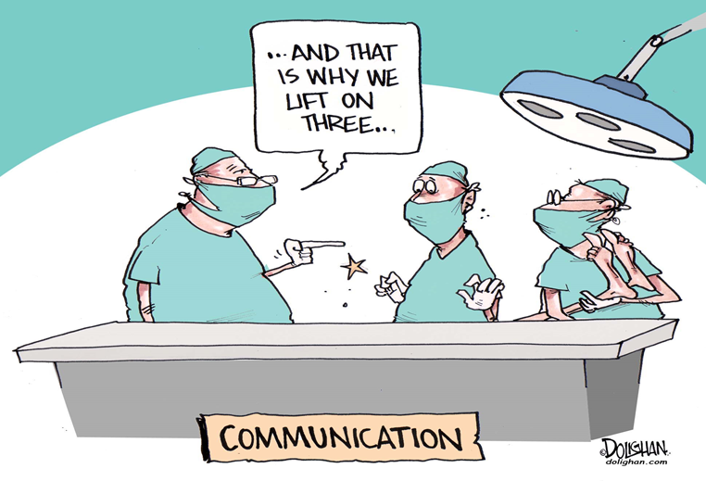
Importance of Good Communication
https://www.youtube.com/watch?v=kTcRRaXV-fg
Notes:
Abbott and Costello – Whose on first
Start the video at 1.30 or it gets long
Talk about communication – what was the breakdown in their communication?

Slide 7
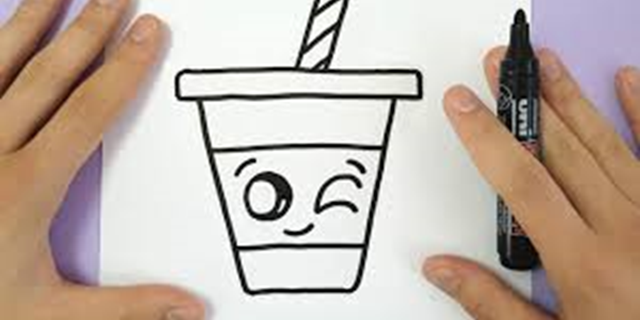
Clear Directions
Notes:
One person in front of the room will give directions to the others
The trainer takes one partner into the hallway to describe the task.
Give the participant a folder with a picture of a cupcake or a dog. (it is in a folder to the partner cannot see it when they go back in the room) The goal is to get their partner to draw the item without telling them what it is.
Ask: What could have improved the communication? Was it frustrating? Talk about ways to improve communication
Switch roles
Did anything improve?

Slide 8
Communication is hard work
Notes:
Excellent communication honors other people, it is clear, timely and helps people move toward their goals.
Ask - What types of communication are there? How do we communicate?
Verbal – speak loud enough for others to hear, don’t yell, use inflection, don’t swear, know when to listen and when to talk
Non-Verbal – exude confidence use good posture, no slouching, hands and legs still, keep hair out of your eyes, wear appropriate attire. – Give an example slouch in your chair and ask the group what you are communicating? Does it make a difference how you sit?
Electronic – texting and e-mail – all caps means shouting, limit exclamation points, proper spelling and grammar
How do we improve communication?
Active Listening – listen to understand. Everyone has their own experiences – we want to understand where other people are coming from -
Let the person know you are listening by having good eye contact
Limit distractions
Paraphrase
Ask questions to understand someone
Correct errors respectfully
Don’t make assumptions.

Slide 9
Elevator Speech
https://www.youtube.com/watch?v=LDpe9StfGTA&t=62s https://www.youtube.com/watch?v=4ytYZUN_ArE&feature=youtu.be
Notes:
When we are looking for a job or a volunteer opportunity, we need to be able to talk about ourselves.
An elevator pitch, elevator speech, or elevator statement is a short description of your skills and abilities in a way that any listener can understand it in a short period of time. The idea is that you could describe this on an elevator before you get to the top floor.
Review each video.
Ask the group what they saw.
What worked about each scenario and what did not work.
Talk about the importance of being able to talk about your self in front of other people.

Slide 10
I am AWESOME!
https://www.youtube.com/watch?v=24ZYGxiVU5s
Notes:
Each person in the class will develop an elevator speech. We will practice these at each session going forward and we will share these at our graduation ceremony.
To get started we should be able to answer the following questions. We want to “sell” ourselves and stand out from the crowd.
Answer the following questions:
1. What are your key strengths and skills?
2. What adjectives come to mind that describe you?
3. What is it you are trying to ʹsellʹ or let others know about you?
4. Why are you interested in the company or industry the person represents?
Have each person brainstorm and write down a list of their strengths and abilities that would be most helpful in the workplace.
Show the AWESOME Project video

Slide 11
Who am I? Betsy Gadbois What do I offer? Experienced trainer What is the problem to be solved? I can help your team be successful What are the main contributions I can make? I have a great attitude and a lot of energy What action can the listener take? Can I give you my phone number in case you would like to know more about me
Notes:
To get started fill you the questionnaire
You can use the following questions to start your outline:
1. Who am I? (greeting, name)
2. What do I offer? (my strengths, work ethic, skills, training, experience)
3. What problem is solved? (catchy sentence)
4. What are the main contributions I can make?
5. What action should the listener take as a result of hearing this?
Look at your workbook and come up with answers to the questions listed. This will help you develop your elevator speech. It is important the words you use to describe yourself are words you use every day.

Slide 12
Trainer Slide
Who am I?
What do I offer?
What problem is solved?
What are the main contributions I can make?
What action should the listener take as a result of hearing this?
Notes:
Trainer complete your slide and share with the group. Have each person do the same,
Support each person to finalize their speech. The Problem to be solved is tricky for people.
FINALIZE YOUR SPEECH - Now that you have your outline of your material, you can finalize the speech. The key to doing this is to expand on the notes you made by writing out each section in full.
To help you do this, follow these guidelines:
1. Take each note you made and write a sentence about it.
2. Take each of the sentences and connect them together with additional phrases to make them flow.
3. Go through what you have written and change any long words or jargon into everyday language.
4. Go back through the re-written material and cut out unnecessary words.
5. Finalize your speech by making sure it is no more than 90 words long. (30 seconds)
Practice your speech to others. Practice, practice, practice.
If people do not finish the activity have them complete it as homework. Suggest that people find someone that can help them.

Slide 13
Elevator Speech
Hi may name is Betsy Gadbois.
I have 25 year of experience as an organizational trainer. I have a lot of energy and I always make training fun.
I can help you build a great team.
Can I call you or your or give you my number so we can talk more?

Slide 14
Homework
Finish your elevator speech and practice with family or friends.
Listen for good communication.

Slide 15
Thoughts or Questions?

