Slide 1
Career Skills 101
Session 5
Notes:
Do not greet people as they come in. See if people notice. Talk about the difference in how people felt welcomed. How do we want to make people feel.

Slide 2
Ice Breaker
Notes:
Ice Breaker: Leader will ask review questions – Trainer should add additional relevant review questions.
Sessions in Review
T or F- All CEOs are leaders
A mission moment is an example of what
Name 1 of thing you should do in a proper greeting
Setting goals is important. Name one of the famous people who set a goal and achieved it! (Rowlings, Sanders, Winfrey)
What does GRIT mean?
Place a “+” sign on my mirror will remind me that my (attitude) is important!
Share one thing you do to get to work BEFORE time.
When my co-worker doesn’t show up for work, I ___(Fill in the blank)___.
I am the CEO of my own _________
T or F - Most companies have an attendance policy.
What is an Ice Breaker?
T or F You should know what a company’s mission statement is before taking a job.
The leader will ask them the next question, and so on....
Or
Instructions:
Have each person stand in front of the group
Hold the potato in your hand between your thumb and pointer finger. Hold the straw in your other hand with your thumb over the top (like you were going to stab something with the straw).
Say out loud “I can do this” 3X’s. On the 3rd time, stab the straw into the potato. The straw will go through the potato.
If for some reason the straw does not go through the group should shout encouraging words.
Ask: Have a conversation about confidence. Did you have confidence that you could do this? What happened when you felt support from co-workers? How can you better support your teammates? What happens when you feel support from others? Was this leadership?

Slide 3
Homework
Finish your elevator speech and practice with family or friends.
Listen for good communication.

Slide 4
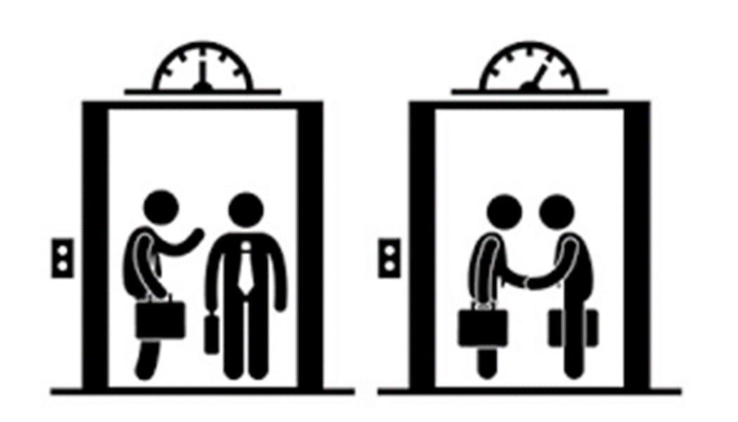
Elevator Speech
Notes:
Ask each participant to stand up and read their elevator speech. Provide feedback as needed. The goal is to get to the point where they can do this with minimal reading.

Slide 5
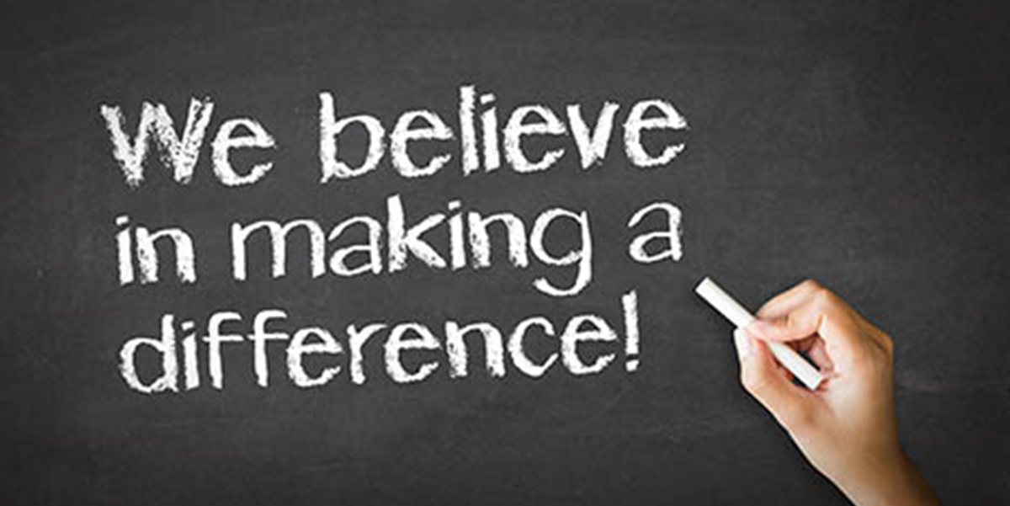
Mission Moments
Notes:
Mission Moments are everyday stories of great things happening in your organization that match your mission.
I define a “mission moment” as a tiny, powerful example of how your organization is making an impact. The key is: it MUST be an example about a real person. Even if you do advocacy work or are an environmental charity, it has to be a people story. Mission moments put a face on what you do. They are stories and examples that can be repeated by others because they are short and inspiring.
They allow you to brag about your work through someone else’s eyes
Each class will start with a Mission moment.
Instructor share a mission moment about the great things your organization is doing. Ask for other stories and ask participants to be thinking about a mission moment for out next class.
When you are looking for a job you want to be sure that the mission of the organization matches your personal values. Personal values are what is important to you at work. What if it doesn’t?

Slide 6
Thought for the Day
Work Ethic eliminates fear. So, if you put forth the work, what are you fearing?
Notes:
Each class will have a thought for the day. Share the thought for the day and ask the group what it means to them. Share what it means to you.
You can change the thought for the day if you have one that fits better for you.

Slide 7
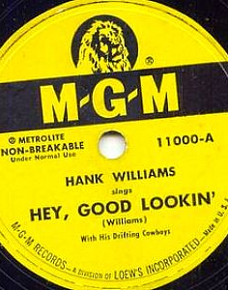
Workplace Appearance and Hygiene
Notes:
Ask the group what is important about workplace appearance and hygiene?
How you look leaves an impression on others, employers and potential employers.

Slide 8
Dress Code Policy
Notes:
Insert your organizations dress code policy. Review each item
Ask – what does the policy say? Discuss smells in workplace – perfume, cologne, importance of good hygiene deodorant, check self in mirror before you leave, hair out of eyes
Tattoos? Piercing? Gaged ears?
Discuss what is appropriate attire: clean, unwrinkled, safe and within the dress code rules
Discuss what is not appropriate attire: not weather appropriate, etc.
Activity – pass out cards, work in teams to determine what is appropriate at your organization?
What have you seen? Observed about hygiene?
Talk about Community Employment, when people tour your organization, when you want a volunteer job
Do these things matter

Slide 9
First Impressions
Notes:
Ask the group what is a first impression
1st impressions – not always right, but very real; You have 15 seconds to make a 1st impression
Ask: what impression did you have of me? What impression did you leave with me when you came to the first session?
Have the group generate a list of things they can do to create a positive first impression.
What impression do we want to give to other people?

Slide 10
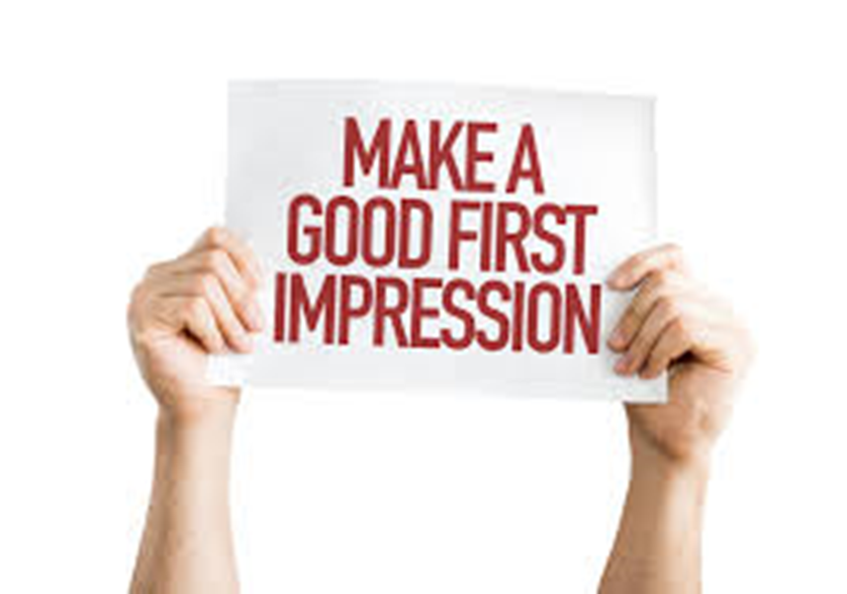
https://youtu.be/8UwjIoIt1L8
Notes:
Show the first impression video. What did you see?
Do the things you see match what was on your list? Do we need to add to the list?
What did you see that made a poor first impression?
Have you ever done any of those things?

Slide 11
What is your Reputation?
Reputation is the general belief of opinion people have about you.
Reputation is how people consider, or label you – good or bad.
Notes:
Built on choices and decisions we make
Have any of you done something you would not want other to know about i.e. illegal, unsafe, or your grandma would not approve of?
Consider the Grandmother Rule: Grandma would not approve; I don’t want Grandma to know about it. This can be a guide for reputation.
Why is this important?
Why is it important when looking for a job?
Other things to consider that impact your reputation
Who do you hang out with?
What types of things do you do?
Are you kind and generous to others?
Have you been a bully?
Does our appearance impact our reputation? Our hygiene?

Slide 12
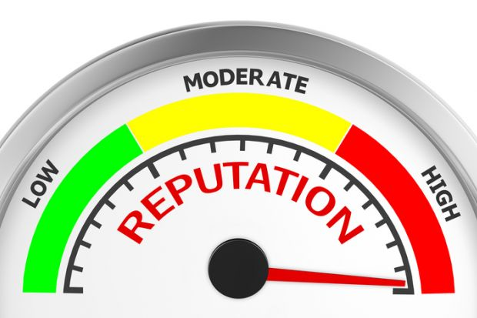
Personal Reputation
Notes:
Place a tape line on the floor
On one side is a perfect/pristine reputation on the other end is needs great improvement
Ask the group to stand on the tape line where they think their reputation is. Ask each person why they chose that spot?
What can we do to improve our reputation?
What can we do to improve the reputation of others?
Speak kindly
Build people up

Slide 13
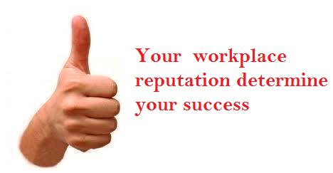
Work Place Reputation
Notes:
Activity: do reputation scenarios 1-5; discuss with group (depending on time leader can read or give a scenario to each group and have them present)
Discuss how your reputation impacts you, your organization and your ability to find a job.
Scenario 1
I have been invited to a party at my best friend’s house. My best friend is moving to another state tomorrow and I likely will not see her/him again for many years. We have been through good and bad times together since high school.
I have a presentation due to my boss first thing tomorrow morning. I don’t have it done. I have never missed a deadline and always come prepared to work. My reputation at work is really good. I am also sure that if I do well on my presentation, I will get a promotion.
How will my decision impact my reputation?
Why should I care?
What should I do?
Scenario 2
People at work know me as a positive team member. I work hard to lift people up and lead from where I am. I am friendly!
A new employee has been hired who doesn’t like me much. It bothers him that I am more popular at work than he is. He has begun saying nasty things about me to other people. I am nervous that my reputation will be damaged.
How do you feel about this?
Why is reputation important to you? Why should you care?
Why is reputation important on the job?
Scenario 3
My reputation at work is not good. My co-workers don’t talk much to me. They actually think I don’t care about them or the work we do. People say I am crabby and hard to get along with. I really keep to myself.
I really do like people. I usually don’t know what to say to my co-workers. It is hard for me to start a conversation. I would like to turn this around and have people think well of me but I don’t know how to do this.
How does this make you feel?
Why is this important?
What first steps should I set to turn this around?
How long do you think this will take?
Is there anyone that can help me?
Scenario 4
My employer has a really good reputation. We are known to be respectful to all employees, that we deliver products on time and that the quality of our work is excellent.
Yesterday I was at the grocery store and overheard one of my staff complaining about MDI. He was saying that it was a lousy place to work, that he wasn’t paid enough and that his supervisor was mean. He was saying this to the cashier in the check-out line.
How important is a business’s reputation? Why?
How hard or easy is it for a business to lose it’s good reputation?
What might you do if you are in this situation?
Scenario 5
Your personal reputation is important.
How does not following the dress code to work affect your reputation?
Your on-line personal reputation is important.
How would negative things you say on-line impact your ability to get a job?
How would positive things you say on-line impact your ability to get a job?
How would a negative or positive reputation on line impact your ability to keep a job?
What can you do to change a negative on-line reputation?

Slide 14
tu.be/SBxcGjt2DCE
Notes:
The things you do in your personal life can have an impact on your work life or your ability to get a job.
Watch the video (TV news report: YouTube: How Your Online Reputation Can Cost You a JOB
Discuss what people saw.
Ask do people have things on Facebook or twitter that a potential employer would not like?

Slide 15
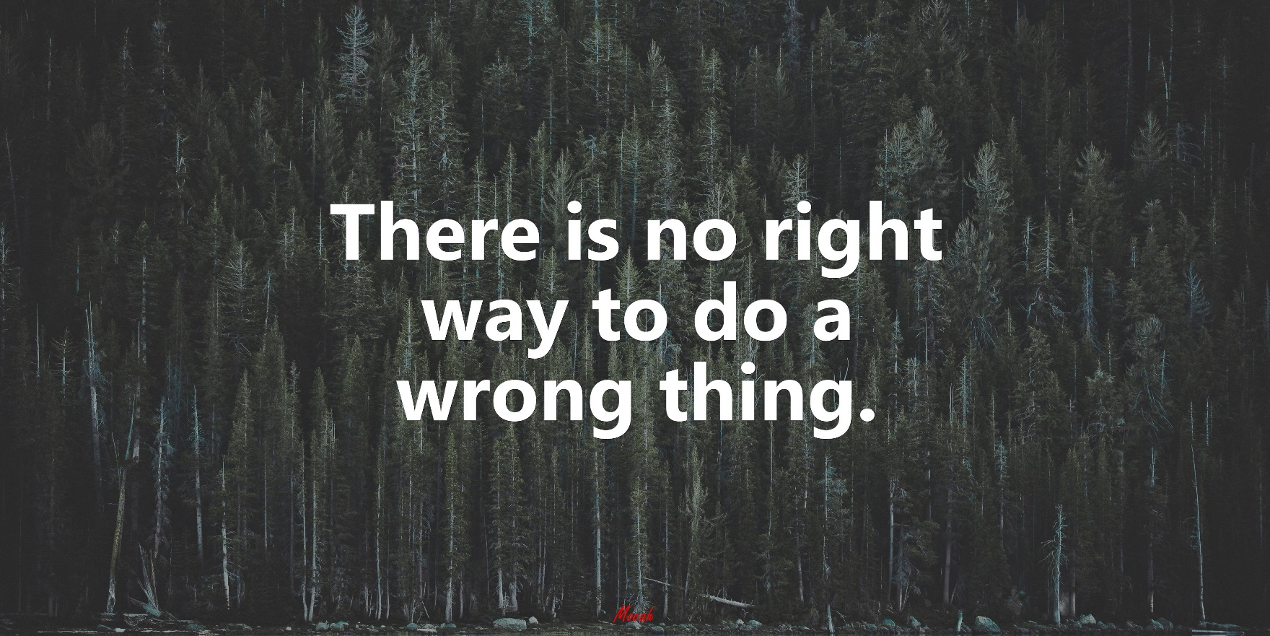
Work Ethic
Notes:
Ask: When someone says “you have a good work ethic” what does that mean?
There are choices we make each day both at home (things that impact our work) and those at work.
Our work ethics actually begins developing or forming when we were small kids. It is the internalized view of work as something that can express or reflect oneself.
We need to remember/understand that our ethics may change with time and from situation to situation
Do we make the same mistake over? Decisions we make have good consequences and poor consequences – we learn from them
Your organization has a set of rules that employees are expected to follow. Your organization may have a code of ethics. (may also be called standards of practice, work standards)
Pass out the code of ethics.
Review with the group?
Ask - What happens if we follow policy? What happens if we don’t?

Slide 16
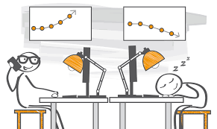
Good and Bad Work Ethics
Notes:
Activity:
Work in small groups - On Flip Chart paper, draw line down middle make a list with small group – list good and bad work ethics.
What do you see when someone has a good work ethic? Ideas include:
Being on time
Listening to co-workers and leaders
Positive attitude
Not using cell phone
Being honest and truthful
Dependable
Responsible
Rigor
What you see when someone has a bad work ethic. Ideas:
Showing up late, or not showing up at all
Not holding quality standard
Yelling at co-worker or leader – ignoring
Using phone on line
Lying about an issue
Stealing
Not working your hardest
Why is this important? How is this important to MDI? Do community employers feel the same? If work ethic is poor, is reputation impacted?
We can be challenged when faced with important decision concerning work and our personal ethics.
Why is this important? How is this important to your organization? Do community employers feel the same? If work ethic is poor, is reputation impacted?
We can be challenged when faced with important decision concerning work and our personal ethics.

Slide 17
Work Ethic Quiz
Notes:
Self-Quiz: What is Your Work Ethic?
Activity: take the work ethic quiz. It will not be turned in so be honest as you complete it.
Are you reliable? Can people count on you?
Never Seldom Sometimes Usually Always
Do you follow rules?
Never Seldom Sometimes Usually Always
Do you honor your word?
Never Seldom Sometimes Usually Always
While working, do you ever do other things?
Never Seldom Sometimes Usually Always
Are you true to the promises you make?
Never Seldom Sometimes Usually Always
Are you a hard worker?
Never Seldom Sometimes Usually Always
Do you work to your highest potential?
Never Seldom Sometimes Usually Always
Most employers find a strong work ethic the best thing an employee can possess. Even if the employee does not have full understanding of the job responsibilities, if he has a strong work ethic, employers usually will be happy to teach and train.
Ask: Would it be better to have an employee who had a lot of knowledge about the job, but was unreliable, or an employee who didn’t know very much about the job but worked extremely hard?

Slide 18
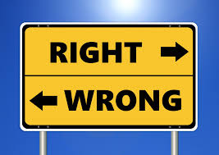
Work Ethics
Notes:
Activity – Work Ethic in Action Scenario
Read each scenarios and ask the group to comment if it is ethical or unethical. Add to the poster on good and bad work ethics.
What would you do?
*Going to work when you’re obviously sick and possibly contagious.
What would you do?
*Telling an insecure co-worker their work is good when it is not.
What would you do?
*Voicing support for a decision you don’t really believe in because everyone else is in favor of it.
Decisions can be tough
There is generally a “better” answer
Can the conflict be eliminated?
Decide what is “more right”.
Seek Advice.
Answers:
It is right to want to meet deadlines and keep the organization from being short-handed, but it’s also right to stay home when you are sick so you will get well faster and avoid infecting others.
It is right to protect a co-worker’s feelings especially when the person is insecure, but it is also right to make sure people know when their work is falling short so they aren’t misled into thinking they’re doing fine.
It is right to be supportive of a team decision, but it’s also right to make sure people know where you truly stand on an issue.
If your organization has an ethics hotline, give the number out to participants. If they do not give information on how to contact HR.

Slide 19
Homework
Look at your social media. Is there anything that should be removed?
Pay attention to workplace appearance.

Slide 20
Thoughts or Questions?

