Slide 1
Career Skills 101
Session 6
Notes:
Greet people as they come in, welcome them and say their name.

Slide 2
Homework
Look at your social media. Is there anything that should be removed?
Pay attention to workplace appearance.

Slide 3
Ice Breaker
Notes:
Pair up with someone you don’t know well and ask them three questions.
What do you like to do in your free time?
Tell me about your favorite memory?
If you could go anywhere, where would you go?
Then introduce your partner to the group.

Slide 4
Review your elevator speech

Slide 5
Mission Moments
Notes:
Optional – You could invite a guest to each session to have them share a Mission Moment Story
Review the Mission/Vision and Value of your organization and ask people to share a mission moment.
Mission Moments are everyday stories of great things happening in your organization that match your mission.
I define a “mission moment” as a tiny, powerful example of how your organization is making an impact. The key is: it MUST be an example about a real person. Even if you do advocacy work or are an environmental charity, it has to be a people story. Mission moments put a face on what you do. They are stories and examples that can be repeated by others because they are short and inspiring.
They allow you to brag about your work through someone else’s eyes
Each class will start with a Mission moment.
Instructor share a mission moment about the great things your organization is doing. Ask for other stories and ask participants to be thinking about a mission moment for out next class.
When you are looking for a job you want to be sure that the mission of the organization matches your personal values. Personal values are what is important to you at work. What if it doesn’t?

Slide 6
Feedback or Criticism
https://www.youtube.com/watch?v=fbp-zwNp-qg&feature=youtu.be
Notes:
Read the slide to the participants. This session is on responding to supervision and authority.
Ask – What is criticism and feedback
Construct - is to build up
Criticism – is used to express disapproval
Feedback - is used for improvement
Give examples and ask for examples from the group on Criticism and feedback.
Show the video on how to give constructive criticism
Work with a partner or in a small group.
Is this criticism or feedback? Mark “C” or “F” next to the statement. If you determine it is criticism, re-state to be constructive.
Do you think it would be helpful to put the boxes on the shelf and the office would look cleaner?
This workspace is a disaster. Why do you act so messy?
You always leave your coat on the floor. Hang it up!
If we wash our dishes right away it is easier to get the food off. The lunchroom belongs to everyone.
You are such a slob. Why don’t you iron your work shirt.
I am worried that you will trip. Can you please tie your shoes?
You waste so much time at work.
I am worried that you spend so much money you will not have enough to pay your bills. Would you like help with a budget?
Your necklace is pretty but it is not appropriate here because it could get caught in a machine.
That is such a stupid shirt to wear to work.
Gosh you are always late. Can’t you get your lazy self out of bed on time!
I like to make my lunch the night before so that I can get to work quicker. Do you think that would be helpful to you?

Slide 7
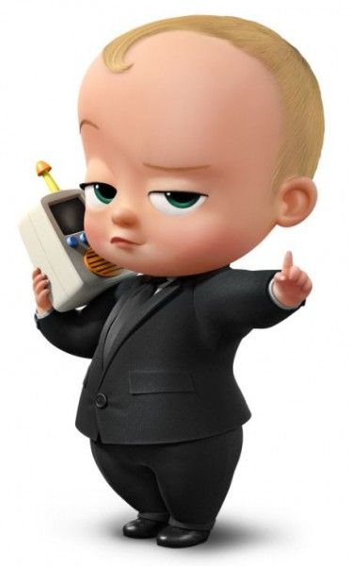
Supervision
Notes:
Talk about supervisors – what is their role?
Create a list with the group
What if your supervisor gives you a task to complete? What should you be thinking about? (put bullets on flip chart)
Is it safe?
Do I have questions about the duty?
Do I know how to do it?
Do I need help?
Do I need more information?
Talk with your boss. There is always more to a story. We often don’t know how a situation ends.
Give situation in which you may need to talk to the supervisor and practice giving feedback.

Slide 8
Feedback is a GIFT!
Notes:
Activity: Give each participant an envelope and set of small cards (use index cards cut up) equal to the number of participants.
Participants should write their name on the envelope
All envelopes would be placed on a table or counter
Have each participant write something nice on each card specific to their classmates (ex. You are funny. You are hard worker. You made me feel welcome on my first day. I appreciate that you helped me on the workfloor.
When people finish writing on the cards, they should put it in the appropriate envelope
Then have people read what feedback they received.
Talk about the benefit of positive feedback.

Slide 9
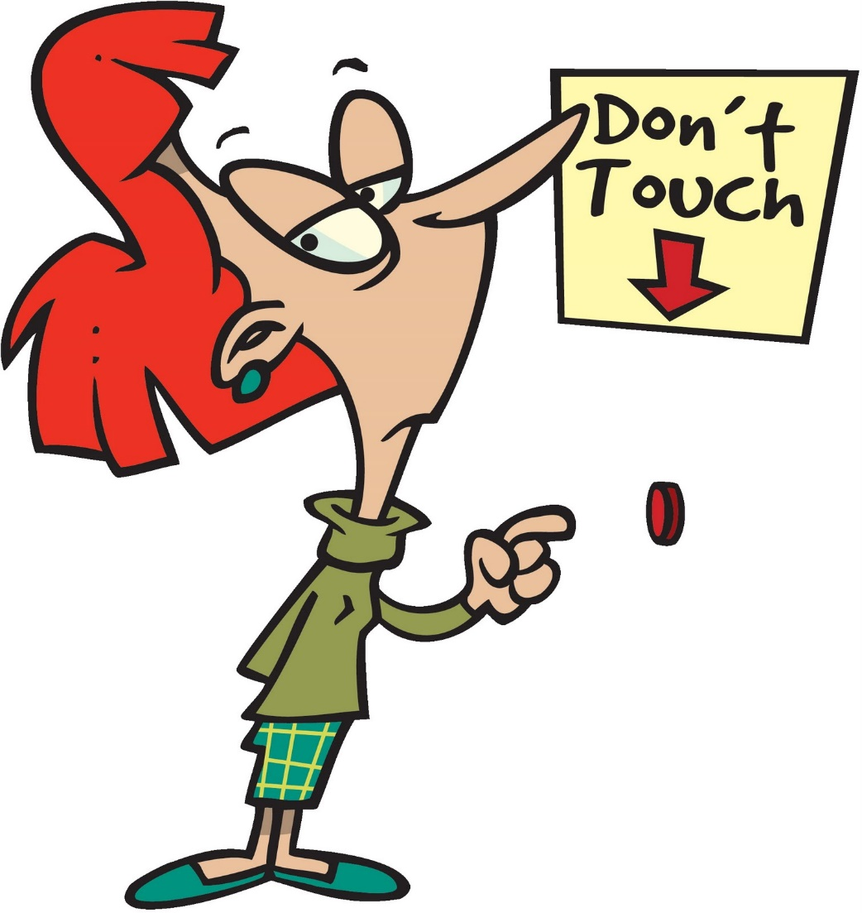
Quality
Notes:
Raise your hand if you believe you are an efficient worker.
What does being efficient mean to you?
What does it mean to be efficient at your job?
Being confident helps provide greater work efficiency – efficiency provides value to your employer, teammates, you
Quality and safety cannot be sacrificed/compromised because it costs
Sometimes health
Sometimes revenue
Activity: Explain the next exercise. Hang up a flipchart page with the time vs money on it.
Time vs. money – on a flip chart
10 seconds = $1.00
20 seconds = $2.00
30 seconds = $3.00 etc
Let's say this is the amount of money it cost your organization to complete a task
Ask someone to do a task – record the time. (Pick up a tote or grab something from another room) record the time and how much it costs.
Ask another person to do the same task, record the time and cost
What cost the company more – should you go faster? Why or why not? What if I dropped the tote?
Give your best effort, evaluate your work, utilize feedback to improve work performance
Activity: on flip chart record answers to What does Quality Look Like at your organization?
Trainers add your examples here.
MDI examples include:
Giving best effort
Improper palletized
Rejected product
Hands stop moving while talking
tin in aluminum bin
Evaluating your own work Utilizing feedback to improve your work
Strive to meet quality standards
Display positive work habits

Slide 10
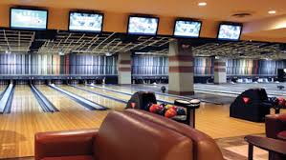
You are the boss
Notes:
Put on your BOSS hat. Now you are a business owner. Talk about quality work.
What would you want to see from your employee

Slide 11
Thought for the Day
Without hard work, nothing grows but weeds.
Notes:
Each class will have a thought for the day. Share the thought for the day and ask the group what it means to them. Share what it means to you.
You can change the thought for the day if you have one that fits better for you.

Slide 12
Homework
Give someone feedback and be prepared to tell the group about it
Be punctual
Pay attention to the quality of your work – do your best
Practice your elevator speech.

Slide 13
Thoughts or Questions?

