Slide 1
Career Skills 101
Session 7
Notes:
Greet people as they come in, welcome them and say their name.

Slide 2
Homework
Give someone feedback and be prepared to tell the group about it
Be punctual
Pay attention to the quality of your work – do your best
Practice your elevator speech

Slide 3
Ice Breaker
Notes:
Tell a story about teamwork
When did you work together with others to make something happen. This can be at work, home or something you did in your community

Slide 4
Review your elevator speech
Notes:
Ask the group to decide who should share their elevator speech at Graduation

Slide 5
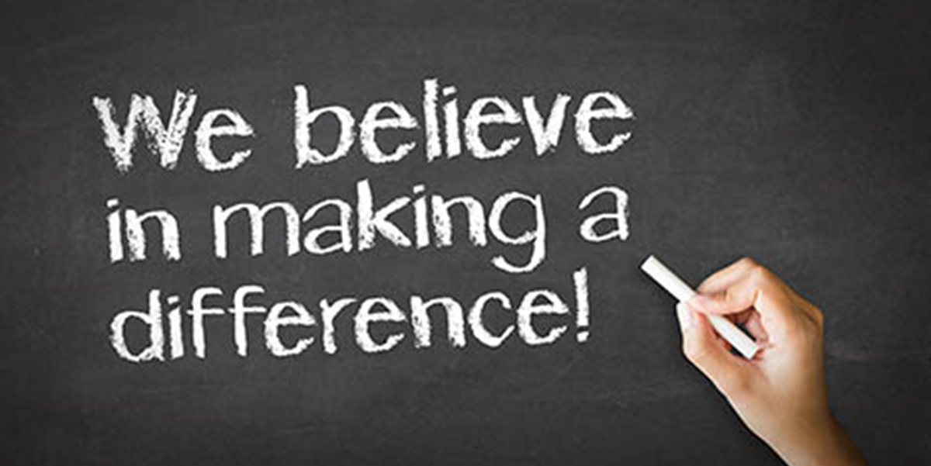
Mission Moments
Notes:
Optional – You could invite a guest to each session to have them share a Mission Moment Story
Review the Mission/Vision and Value of your organization and ask people to share a mission moment.
Mission Moments are everyday stories of great things happening in your organization that match your mission.
I define a “mission moment” as a tiny, powerful example of how your organization is making an impact. The key is: it MUST be an example about a real person. Even if you do advocacy work or are an environmental charity, it has to be a people story. Mission moments put a face on what you do. They are stories and examples that can be repeated by others because they are short and inspiring.
They allow you to brag about your work through someone else’s eyes
Each class will start with a Mission moment.
Instructor share a mission moment about the great things your organization is doing. Ask for other stories and ask participants to be thinking about a mission moment for out next class.
When you are looking for a job you want to be sure that the mission of the organization matches your personal values. Personal values are what is important to you at work. What if it doesn’t?

Slide 6
TEAMWORK
Notes:
Activity: On Flip Chart record – or ask for a volunteer to record for the group
What is a good team member?
Examples: reliable, dependable, honest, positive, reassuring, resourceful; helpful
What is a bad team member?
Late, lazy, rude, does not help others
Everyone either can contribute to a team (or other’s lives) or can take away from a team.
We need to work together with all kinds of people. We need to use our strengths and skills
It takes all kinds of people to build a team.
Remind people of their DISC profile

Slide 7
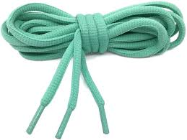
Teamwork
Notes:
Tie-The-Rope
Need fairly long rope/shoelace for each group (group of 3) Raise dominant hand and put behind back. Only use non-dominant hand to work with your -partner to tie the rope around the wrist of one of the partners. After all are completed, discuss what strategies were used to help solve the problem.
(can ask for help, using a knee, talking through first, experiment with different options)
What does this tell us about teamwork?

Slide 8
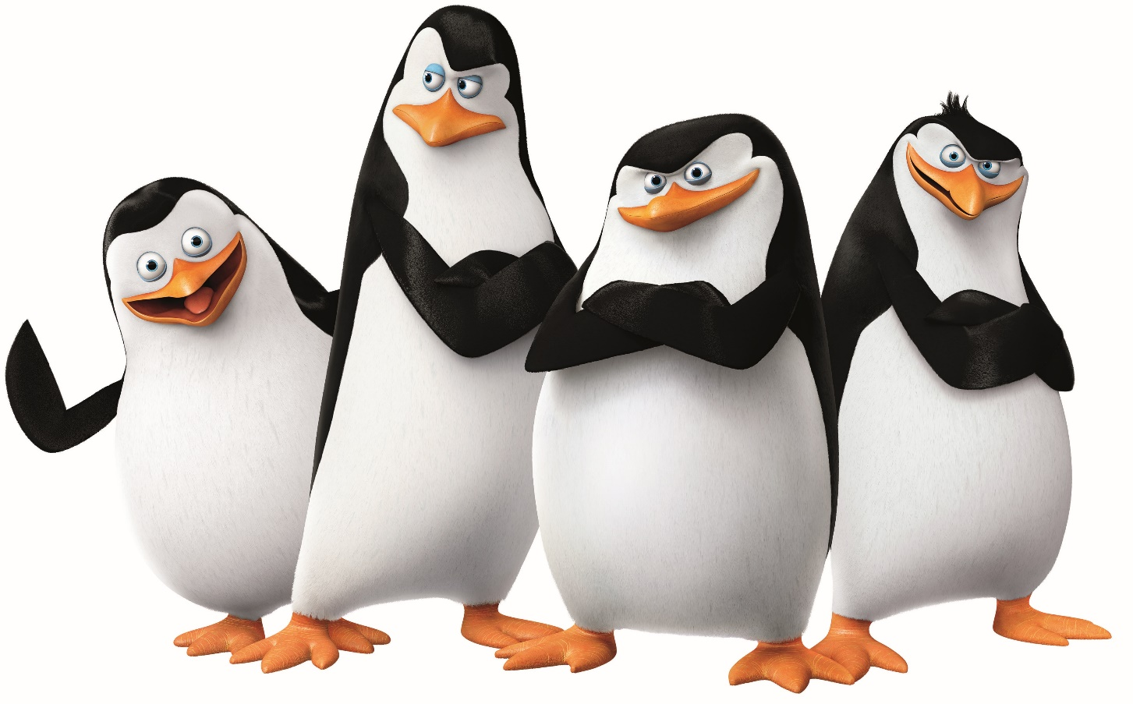
Teamwork
https://www.youtube.com/watch?v=DI4zp7yeuMU
Notes:
https://www.youtube.com/watch?v=DI4zp7yeuMU
Talk about all the things they had to do as a team to steal the car
Was there a leader
How did they respond to errors along the way

Slide 9
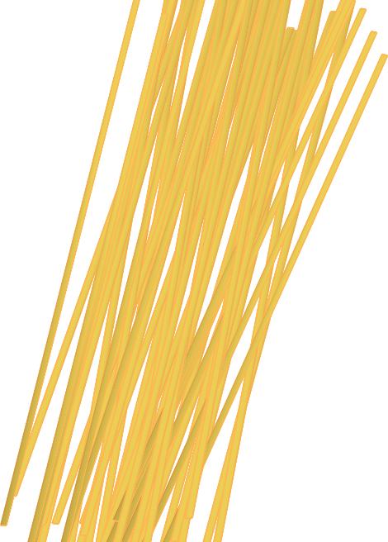
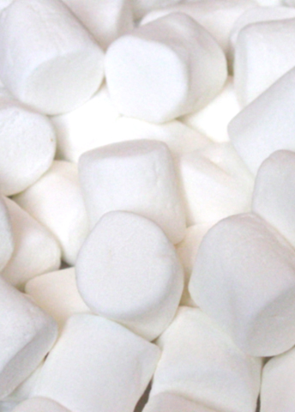
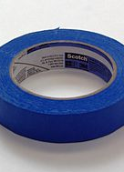
Teamwork and Critical Thinking
Notes:
Critical Thinking and Marshmallow Tower (20 minutes)
Materials are:
Tape (as much as you want)
Spaghetti Noodles (20)
Marshmallow (1)
string (1 yard)
Together we can accomplish more than going it alone.
We can problem solve better as a team than we can alone.
Developing your team's collaboration skills will lead to better problem solving and critical thinking.
The goal of this exercise is to see which team can, using the materials provided, build the tallest tower within the allotted time. The tower must be able to stand on it’s own. The Marshmallow has to be at the top of the tower.
You have 20 minutes to build the tallest tower with a marshmallow on the top
***During the exercise, leader should be taking notes on what characteristics you see that show leadership, critical thinking and teamwork. Share after the exercise.
Who takes over leadership?
Do they ask questions?
Are they sharing ideas?
What about creativity?
Ask – Why are great teams important?
Have a discussion about teams they belong to?

Slide 10
Thought for the Day
Notes:
Each class will have a thought for the day. Share the thought for the day and ask the group what it means to them. Share what it means to you.
You can change the thought for the day if you have one that fits better for you.

Slide 11
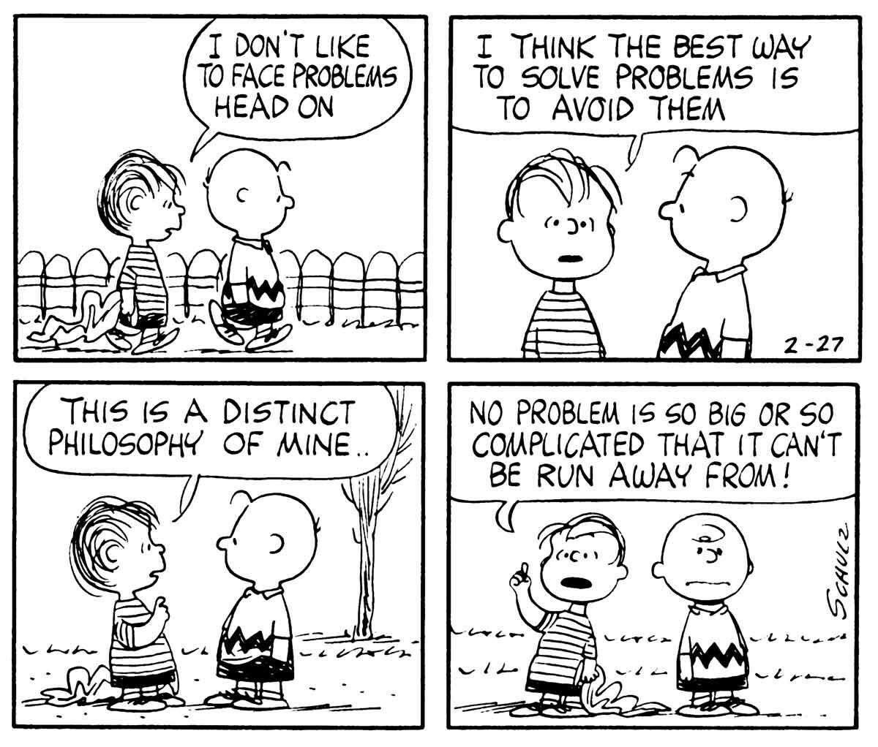
Problem Solving
Notes:
Last session we did a number of activities that required critical thinking and team work. Let’s work together to solve a group problem

Slide 12
Notes:
Human Knot
Instructions: Have everyone stand in a circle and ask each person to hold hands with two people who aren’t directly next to them. When everyone is tangled together, ask everyone to untangle the knot without letting anyone’s hand go to form a perfect circle. This game requires some creativity strategizing!
Will need another activity here.

Slide 13
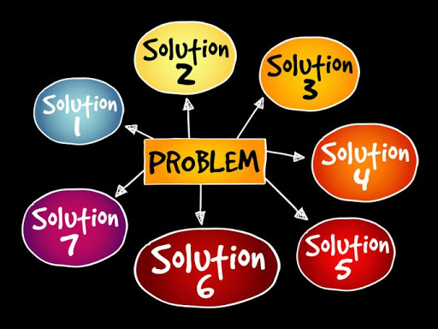
Problem Solving
Be Aware
Identify the problem
Safety
Involve others
Policy issues
Cost $$$
Brainstorm
Prioritize
Act
Test
Ask
Notes:
Trainer be prepared to talk about a problem with the group
Pass out the problem-solving worksheet – talk through each step
Be Aware – Is this a problem? If you are not aware you can never solve it?
Identify the problem - be specific – who, what, where, when
Does the problem involve safety? If immediate danger, get help and look at the larger problem of cause Ex. someone is having a heart attack?
Does it involve others?
Does it involve policy/process/systems?
Does it cost money?
Brainstorm Strategies to solve the problem
Prioritize steps
Act
Test – Is the problem solved? If not, then try the next step
Ask – Is the underlying problem bigger – Go back to Step 2
On a flipchart write down your problem – walk through each step and ask the group to respond. Let them brainstorm solutions for your problem.

Slide 14
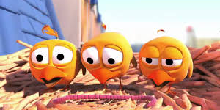
https://www.youtube.com/watch?v=oIlIVFBBbNw
Notes:
Show the pigeon solving video and walk through the problemhttps://www.youtube.com/watch?v=oIlIVFBBbNw solving process
Ask people to answer. The baby pigeons are hungry
Be Aware – Is this a problem? If you are not aware you can never solve it?
Identify the problem - be specific – who, what, where, when
Does the problem involve safety? If immediate danger, get help and look at the larger problem of cause Ex. someone is having a heart attack?
Does it involve others?
Does it involve policy/process/systems?
Does it cost money?
Brainstorm Strategies to solve the problem
Prioritize steps
Act
Test – Is the problem solved? If not, then try the next step
Ask – Is the underlying problem bigger – Go back to Step 2

Slide 15
Homework
Bring and example of teamwork that you have observed
Practice problem solving
Invite people you want to attend the graduation

Slide 16
Thoughts or Questions?

Slide 17
Preparation for Graduation
Notes:
Ask the group to choose 3 people that will read their elevator speeches at the graduation ceremony. This is an example of what we have learned in class. Have the 3 people practice again. Encourage them to try it without the paper. (they can read it at the ceremony if they need to.
Assure the group that their will be roles for each person.

