Slide 1
Session 9
Optional Session
Notes:
Greet people by name, Shake hands as people come into the room.

Slide 2
Hide this slide
Flipchart
Markers
Index cards with matching pairs, Salt and Pepper, Mickey and Minnie
Tape
Safety Officer as visitor
Safety Policy handout
Workplace Culture handout
Safety checklist

Slide 3
Homework
Your thoughts on Graduation
Notes:
If you use this session you might not have homework because the final session was graduation. Change or delete the slide

Slide 4
Ice Breaker
Notes:
Salt and pepper: Come up with pairs of things like salt and pepper, sun and moon, shoe and sock etc. put them on an index card (you can use pictures)
Ask each person to draw and index card. Ask the group to stand up and move around the room to find the person that is the best match/pair to their card. When they find their partner, they should pick up all their materials and sit with their partner for the day.
Safety items would work great here

Slide 5
Workplace safety and culture
Notes:
Handout Workplace Culture Policy and Safety Policy
Review the policies with the group
Ask – What is workplace culture:
Workplace culture is the environment that you create at work. ... It is the mix of your organization's leadership, values, traditions, beliefs, interactions, behaviors and attitudes that contribute to the emotional and relational environment of your workplace
What is the culture of your organization
Ask – What is honesty and what does it look like in your organization?
Ask – What does integrity mean and what does it mean in your organization?
Ask – What is a safe work environment?
Can you find these word in your organizations Mission Vision and Value? Honesty, safety and integrity are key to most organizations mission – Review Mission/Values on wall and find Honesty. Find Integrity in the phases.

Slide 6
Integrity at work
https://youtu.be/ADdkANLRUMQ
Notes:
Watch the video and discuss integrity
Corn field
Pizza Parlor
Best Buy

Slide 7
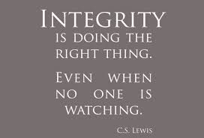
Thought for the Day
Notes:
Each class will have a thought for the day. Share the thought for the day and ask the group what it means to them. Share what it means to you.
You can change the thought for the day if you have one that fits better for you.

Slide 8
Health and Safety
Notes:
Activity: Invite Safety Officer into class to talk about plant safety
Have participants interview safety officer/supervisor. Hand out cards with Questions on them.
Pass out a safety checklist if your organization has one
Discussion: Health and safety is the bottom line –
Ask - Why is this important to your organization? or Any place of employment?
Ask - Why is it important to follow the policies and procedures?
Ask – How unsafe behaviors affect them? Connect everything in this conversation to the M/V/V – it is all connected.
Ask - What if you see a rug/mat on the floor with the edges rolled creating a trip hazard? What would you do?
Ask- What if you lost track of time and go back to work 10 minutes later than you are supposed to? Is this a theft of time? What would you do?
Get examples of safety hazards to watch for. Tour organization. As you tour ask people what they would do about specific things they see. Below are examples from MDI you should insert your own examples.
Rolled rugs
Water spilled on the floor
Clips or paper on the floor
Wet floors
Not performing exercises
Messy work area

Slide 9
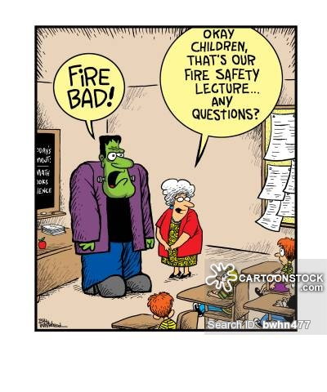
Notes:
Discuss how your organization handles emergencies like fire and weather emergencies.
This will be different for each organization you go to. When you get a job you will learn about the organization culture and safety policies.
Ask - can anyone talk about safety policies in organization you have worked in the past. Trainer should share examples.

Slide 10
Homework
Practice safety everywhere you go
Pay attention to different safety procedures
Think of a time when you demonstrated integrity
Notes:
If you use this session you might not have homework because the final session was graduation. Change or delete the slide

Slide 11
Session 10
Optional Session
Notes:
Greet people by name, Shake hands as people come into the room.

Slide 12
Homework
Practice safety everywhere you go
Pay attention to different safety procedures
Think of a time when you demonstrated integrity
Notes:
If you use this session you might not have homework because the final session was graduation. Change or delete the slide

Slide 13
Ice Breaker
Notes:
Share a story of integrity

Slide 14
Getting a Job
Notes:
Share a story of integrity

Slide 15
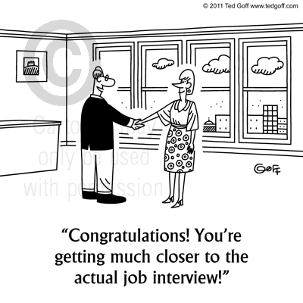
Step 1: Build a Resume
Step 2: Apply for Job
Step 3: Interview
Step 4: Use Career Skills you have learned
Notes:
We will take a closer look at each step
Step One: Build a Resume
Step Two: Apply for Job
Step Three: Interview
Step Four: Accept and Use Career 101 Skills you have learned

Slide 16
Building a Resume
Notes:
Think like an employer.
Networking is key – Expand your social network!
Volunteering is as good as a job. Add it to your resume.
A resume is what gets you in the door. Getting in the door is only 1/3 of the work!
Your resume must have KEY WORDS, ACCOMPLISHMENT STATEMENTS, and SHOW VALUE.
Don’t use the resume templates you find on line. Algorithms can’t read them.
Ask employer if they have a paper application if you wish.
If possible, have someone review your application.
Use your work experiences as headings, not position titles you have had.
List employers 1st…then dates you worked there.
Use professional language.
Don’t use “I” or “responsible for” words. Start with action verbs.
Include military, memberships and certificates on your resume.
References:
Generally don’t list on application
Check with people before using their personal information
Bring a copy to interview

Slide 17
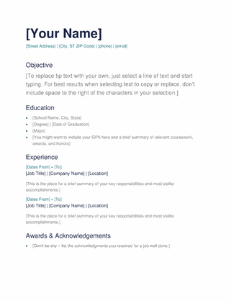
Easy Resume
Make it simple:
Objective
Education
Experience
Awards
Notes:
If you use this session you might not have homework because the final session was graduation. Change or delete the slide

Slide 18
What else?
Certification
Volunteer experiences
Special Skills – Welding
?
Notes:
If you use this session you might not have homework because the final session was graduation. Change or delete the slide

Slide 19
Sample Resume
Notes:
Add your own sample

Slide 20
Sample Resume
Notes:
Add your own sample

Slide 21
Sample Resume
Notes:
Add your own sample

Slide 22
Applying for the job
Notes:
Finding a job
Research employer – examine their website – know the mission products, services – what are they most proud of?
How will your strengths help their mission
Does our elevator speech match their mission?
Bring letters of recommendation for previous employer
Know where you are going - location
Be early
Is there pre-work to be done
Remember you are interviewing them as much as they are interviewing you
Think like an employer.
Networking is key – Expand your social network!
Volunteering is as good as a job. Add it to your resume.
A resume is what gets you in the door. Getting in the door is only 1/3 of the work!
Your resume must have KEY WORDS, ACCOMPLISHMENT STATEMENTS, and SHOW VALUE.
Don’t use the resume templates you find on line. Algorithms can’t read them.
Ask employer if they have a paper application if you wish.
If possible, have someone review your application.
Use your work experiences as headings, not position titles you have had.
List employers 1st…then dates you worked there.
Use professional language.
Don’t use “I” or “responsible for” words. Start with action verbs.
Include military, memberships and certificates on your resume.
References:
Generally don’t list on application
Check with people before using their personal information
Bring a copy to interview

Slide 23
Interviewing
Notes:
We will do this activity as a group. Facilitator will read the question and call on people to answer. Ask if other have a different answer and have a conversation about how to answer the questions.
Activity: Practice Interview Speed Interviewing
Trainer distribute speed interview questions.
Half room on one side of table, other stay seated.
With a partner, practice telling each other what your dream job is.
Ask the questions on hand out. Each person picks one (30 -45 seconds). Then move to next share (See Speed Interview Questions)
Speed Interview Question Activity: Session 11
Tell me something about yourself that others may be surprised to know about you?
Why should I hire you?
Why do you want to work here?
What skill would you like to be better at? Why?
What does work ethic mean to you?
If there were something in your past you were able to go back and do differently, what would that be?
Tell me your biggest success story?
What is your ideal position and

Slide 24
Work Skills
What skills have you learned in class that will help you get a job?
https://www.youtube.com/watch?v=6wC2DqFJ7UE&feature=youtu.be
Notes:
Generate a list of skills learned in class that will help people to get their dream job.
Have a list of the class topics. Ask them how this will help them?
Watch Mrs Doubtfire video

Slide 25
Each step leads to your DREAM job!
Notes:
Trainer should add examples of job and the steps it takes to get there.

Slide 26
Page Title
Text
Notes:
If you are continuing classes add your homework assignment here.

